Slide 1
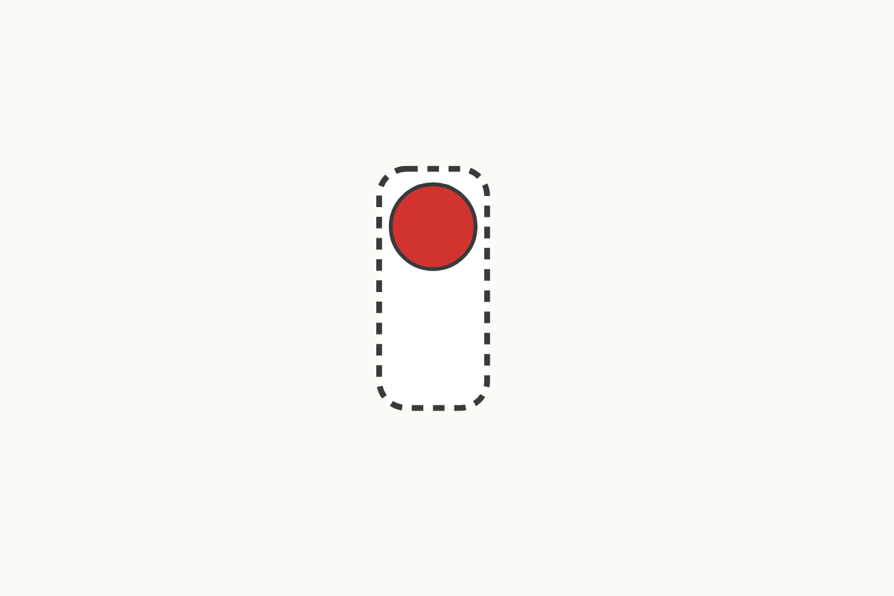
Can every counter find a partner?
1
Education Makes Sense · educationmakessense.co.uk · Clear lessons. Confident learning.
Notes:
Look, we have 1 counter. It's all on its own – there isn't another counter to be its partner. When one is left over like this, we call it an odd number. 1 is odd.

Slide 2
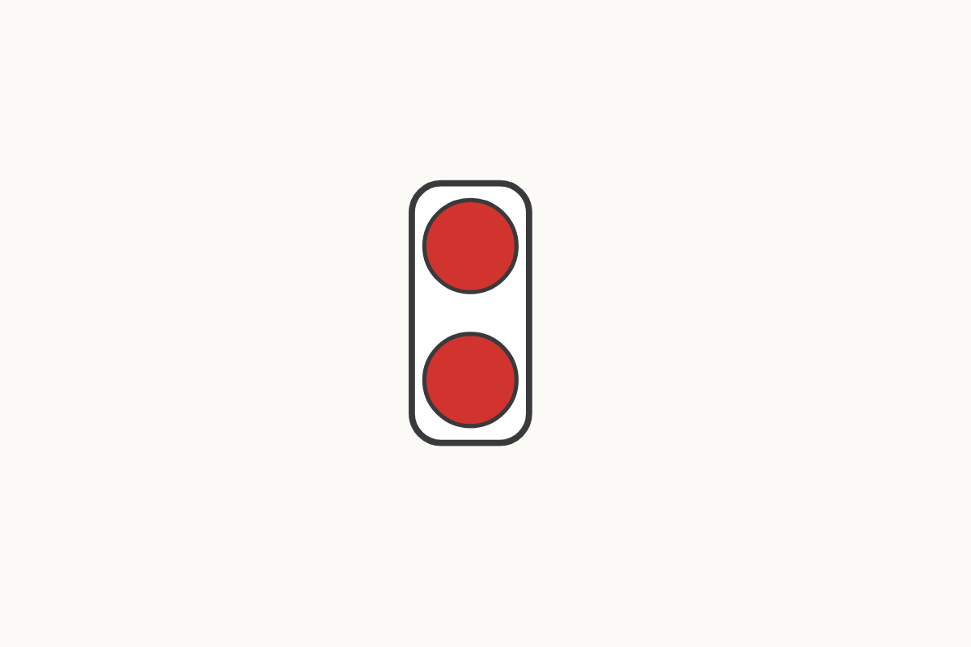
Every counter has a partner
2
Education Makes Sense · educationmakessense.co.uk · Clear lessons. Confident learning.
Notes:
Now we have 2 counters, and look – they've paired up! Every counter has a partner, so 2 is an even number.

Slide 3
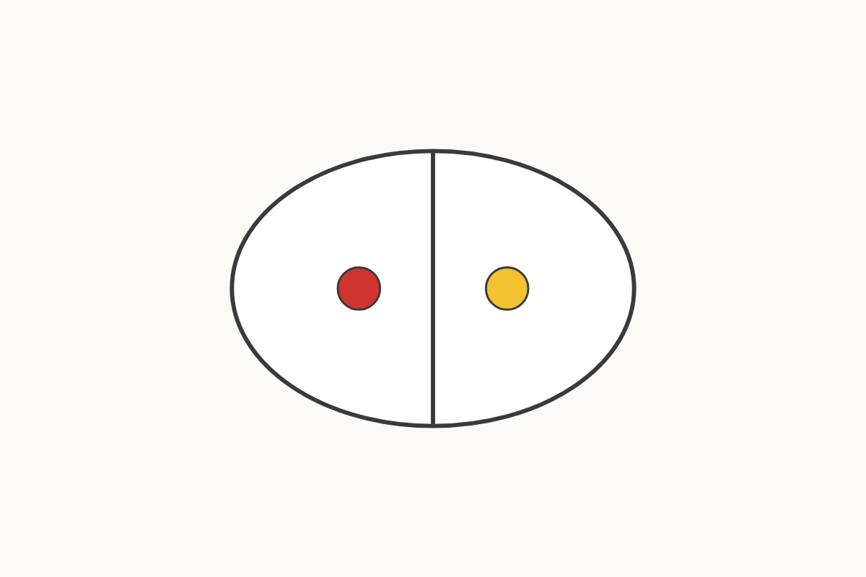
Double 1: the same again
1 and 1
Education Makes Sense · educationmakessense.co.uk · Clear lessons. Confident learning.
Notes:
Our ladybird has 1 spot on this side. If we add the same again, 1 more spot, how many spots does she have altogether? Double 1 is 2.

Slide 4
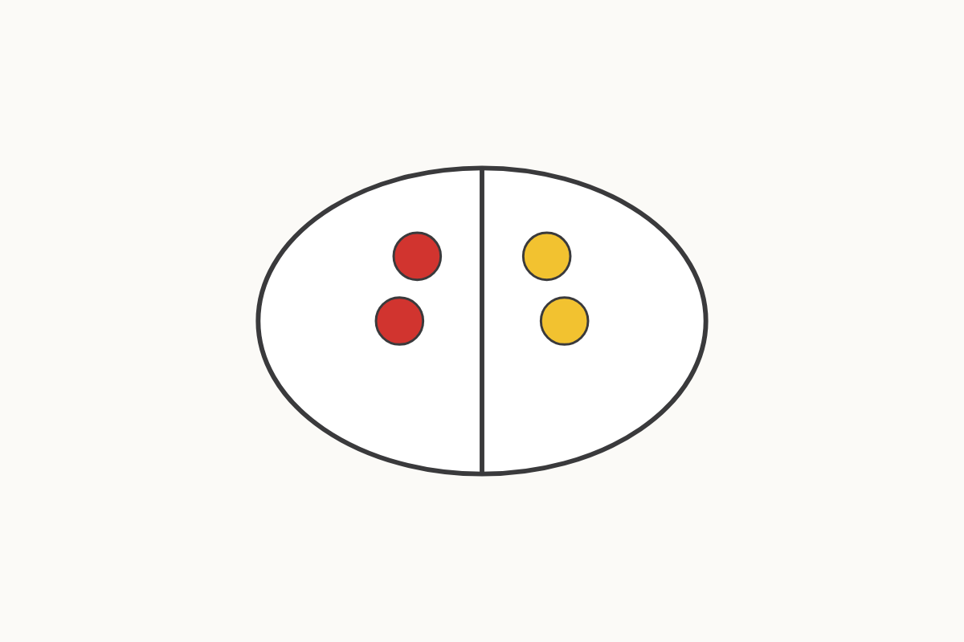
Double 2: the same again
2 and 2
Education Makes Sense · educationmakessense.co.uk · Clear lessons. Confident learning.
Notes:
This ladybird has 2 spots on one side. Let's add the same again – 2 more spots on the other side. Double 2 is 4.

Slide 5
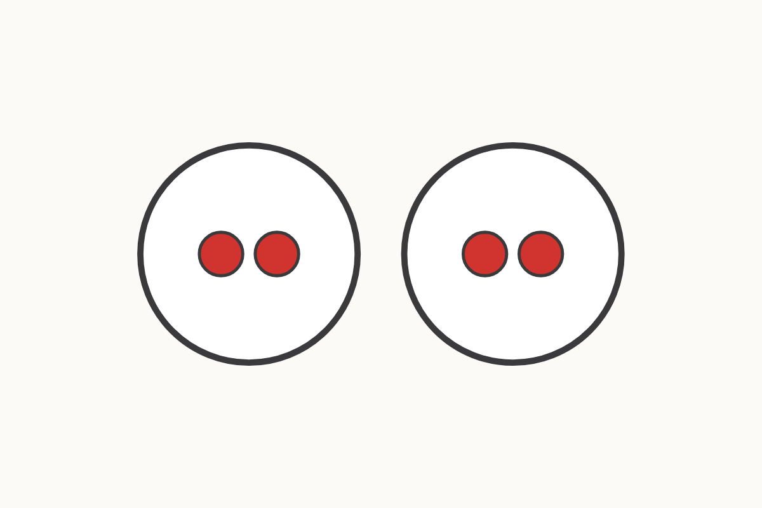
Sharing fairly between two plates
4
Education Makes Sense · educationmakessense.co.uk · Clear lessons. Confident learning.
Notes:
We have 4 counters to share fairly between 2 plates, so everyone gets the same. If we share them out evenly, one at a time, each plate gets 2.

Slide 6
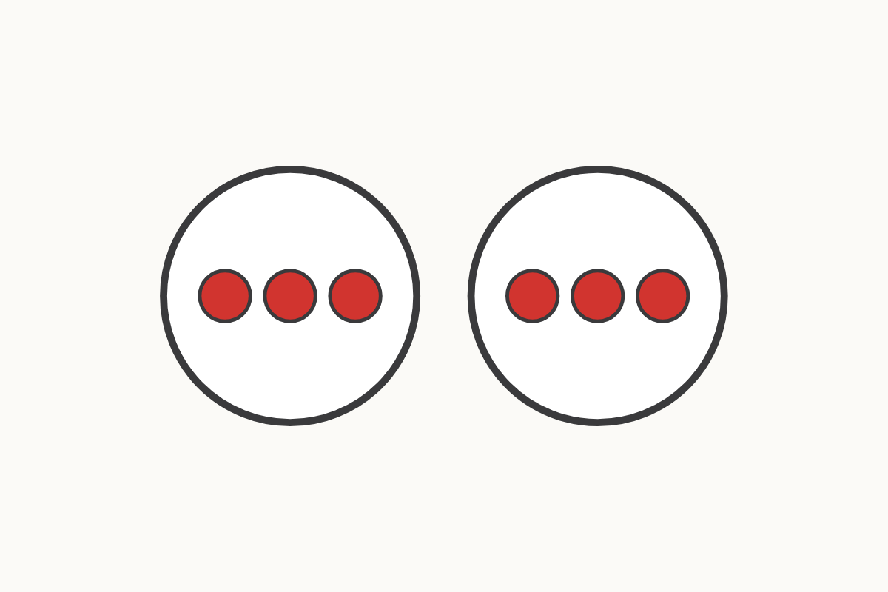
Sharing fairly between two plates
6
Education Makes Sense · educationmakessense.co.uk · Clear lessons. Confident learning.
Notes:
Now we have 6 counters to share fairly between our 2 plates. Let's share them out evenly, one at a time. Each plate gets 3.

Slide 7
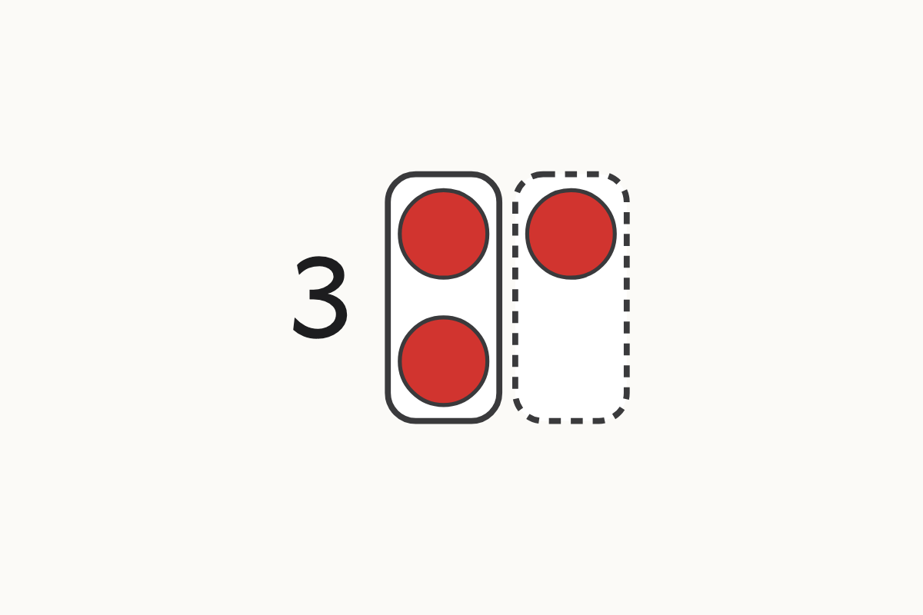
Spotting an odd number
3
Education Makes Sense · educationmakessense.co.uk · Clear lessons. Confident learning.
Notes:
Here are 3 counters. Let's try to put them in pairs... one counter doesn't have a partner! 3 is an odd number.

Slide 8
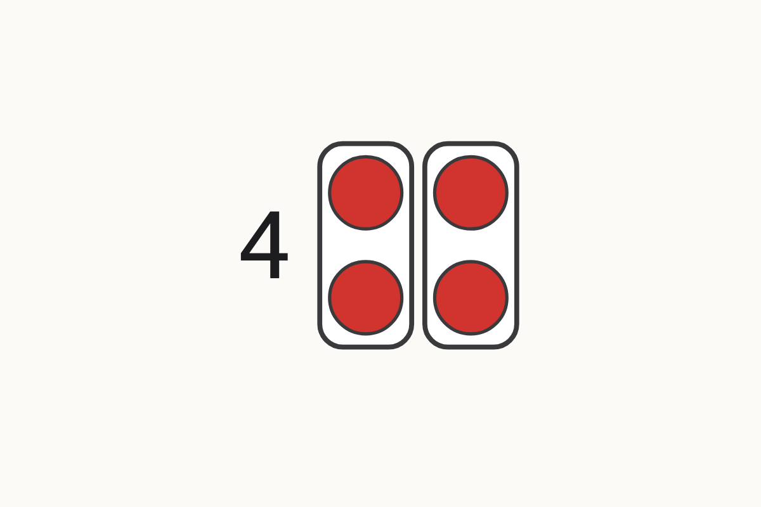
Spotting an even number
4
Education Makes Sense · educationmakessense.co.uk · Clear lessons. Confident learning.
Notes:
Here are 4 counters. Let's put them in pairs... every counter has found a partner! 4 is an even number.

