Slide 1
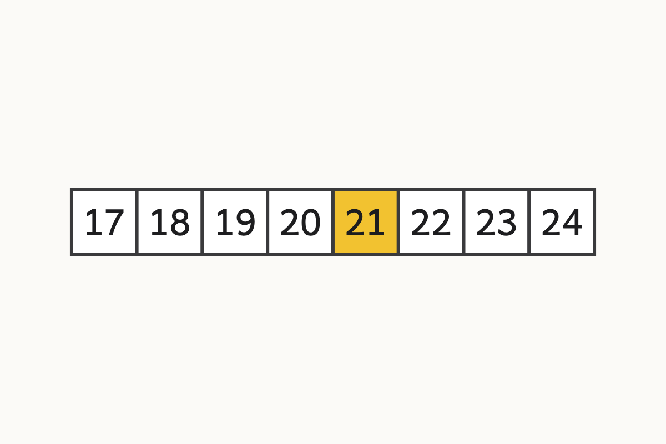
Counting on past 20
20, 21
Education Makes Sense · educationmakessense.co.uk · Clear lessons. Confident learning.
Notes:
Let's count along our track together: 17, 18, 19, 20... what comes next? After 20 comes 21! Point to 21 with me.

Slide 2
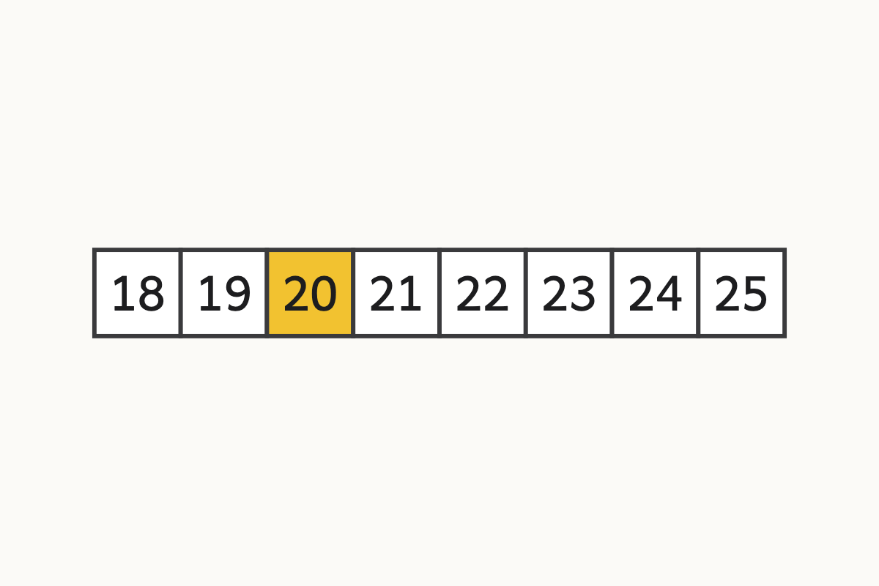
One more than 19
19, 20
Education Makes Sense · educationmakessense.co.uk · Clear lessons. Confident learning.
Notes:
Count with me: 18, 19... one more than 19 is 20. Let's find 20 on the track.

Slide 3
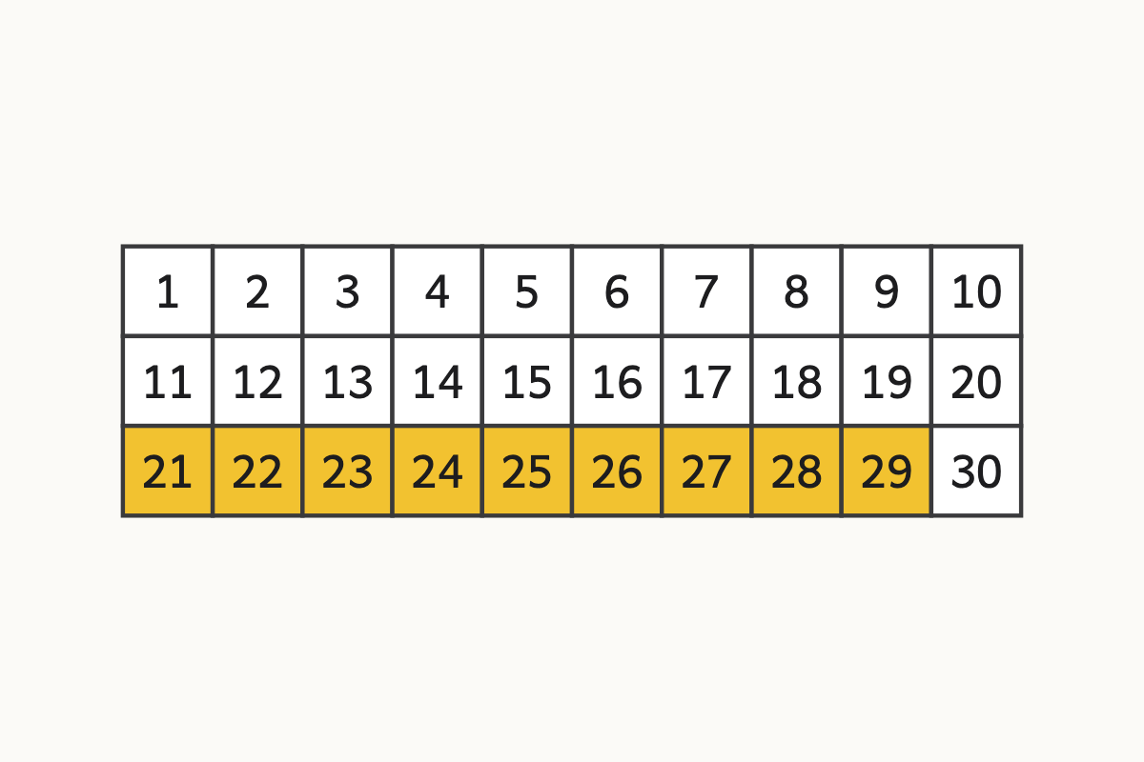
The twenties
21-29
Education Makes Sense · educationmakessense.co.uk · Clear lessons. Confident learning.
Notes:
Look at this row. After 20 it's twenty-one, twenty-two, twenty-three, all the way to twenty-nine. Listen for the 'twenty' at the start each time, not 'twenty-ten'!

Slide 4
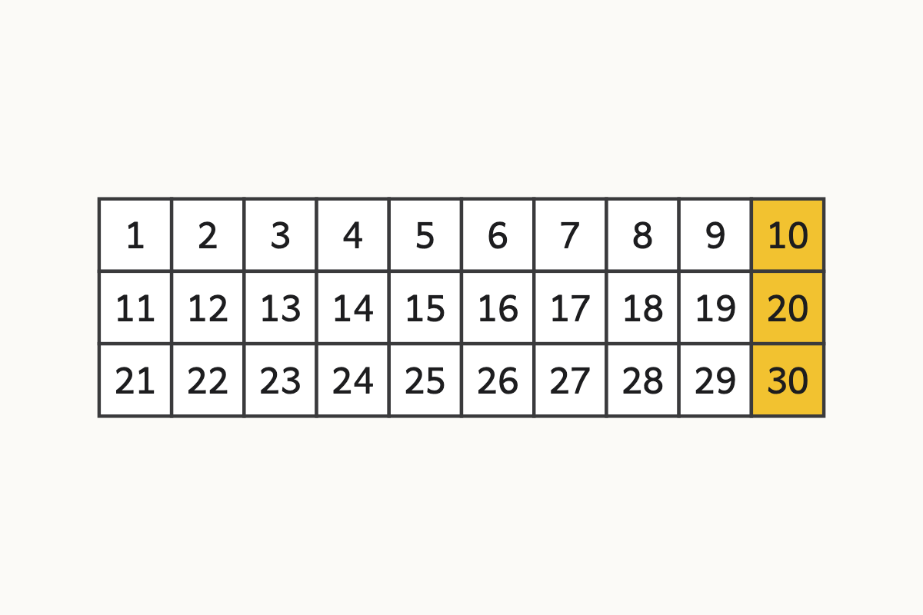
The tens change
10, 20, 30
Education Makes Sense · educationmakessense.co.uk · Clear lessons. Confident learning.
Notes:
After 9 comes 10, after 19 comes 20, and after 29 comes 30. Say it with me: ten, twenty, thirty!

Slide 5
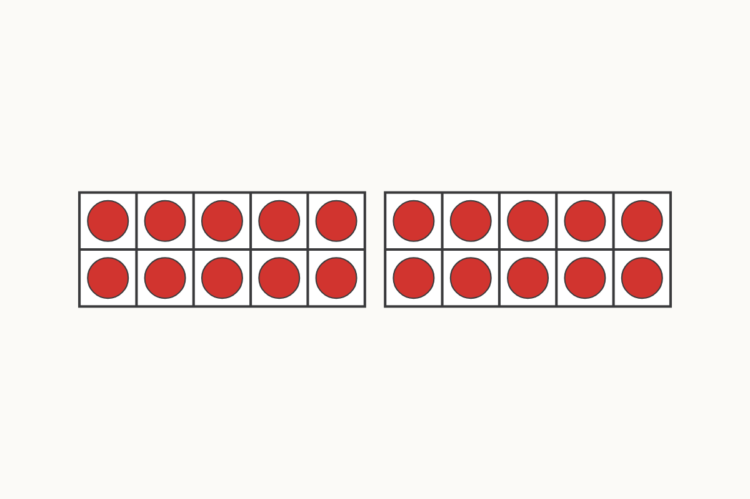
Two full tens
20
Education Makes Sense · educationmakessense.co.uk · Clear lessons. Confident learning.
Notes:
Two full ten frames and no more. How many is that altogether? That's right, 20.

Slide 6
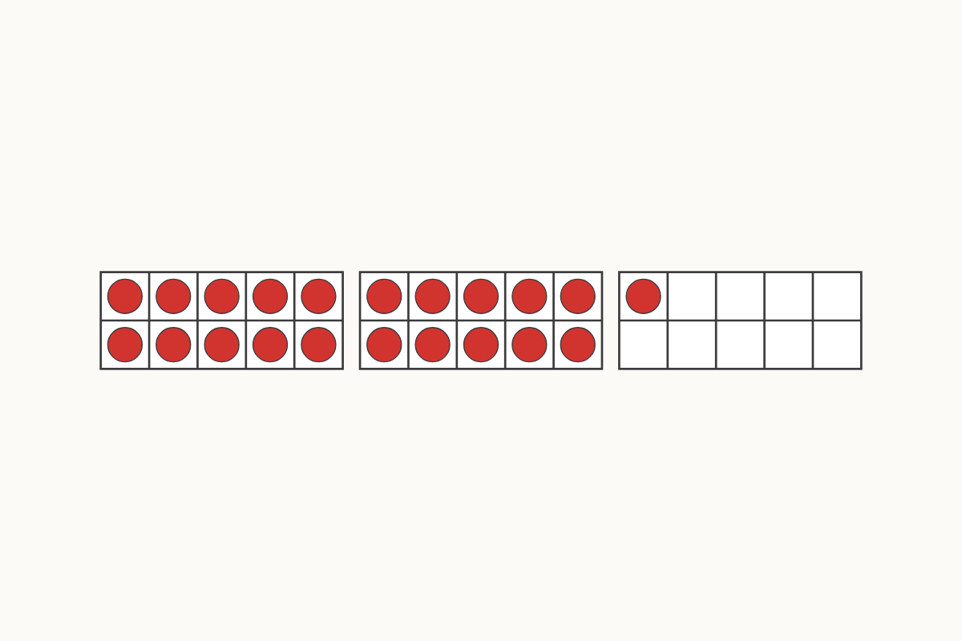
Two tens and one more
21
Education Makes Sense · educationmakessense.co.uk · Clear lessons. Confident learning.
Notes:
Two full ten frames, and one more. Two tens and 1 makes 21.

Slide 7
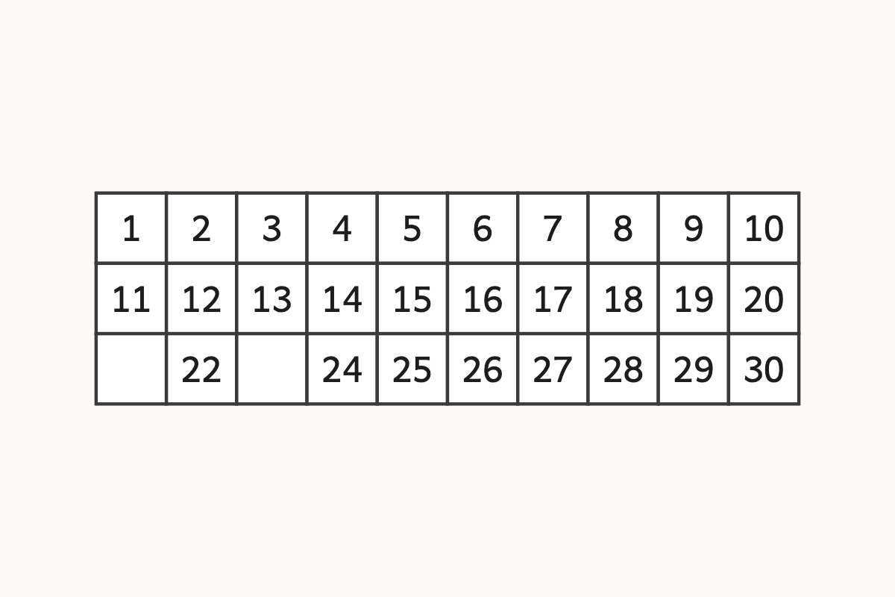
Find the hidden numbers
? ?
Education Makes Sense · educationmakessense.co.uk · Clear lessons. Confident learning.
Notes:
Two numbers are hiding on our square. After 20 comes... 21! And after 22 comes... 23! Well done.

Slide 8
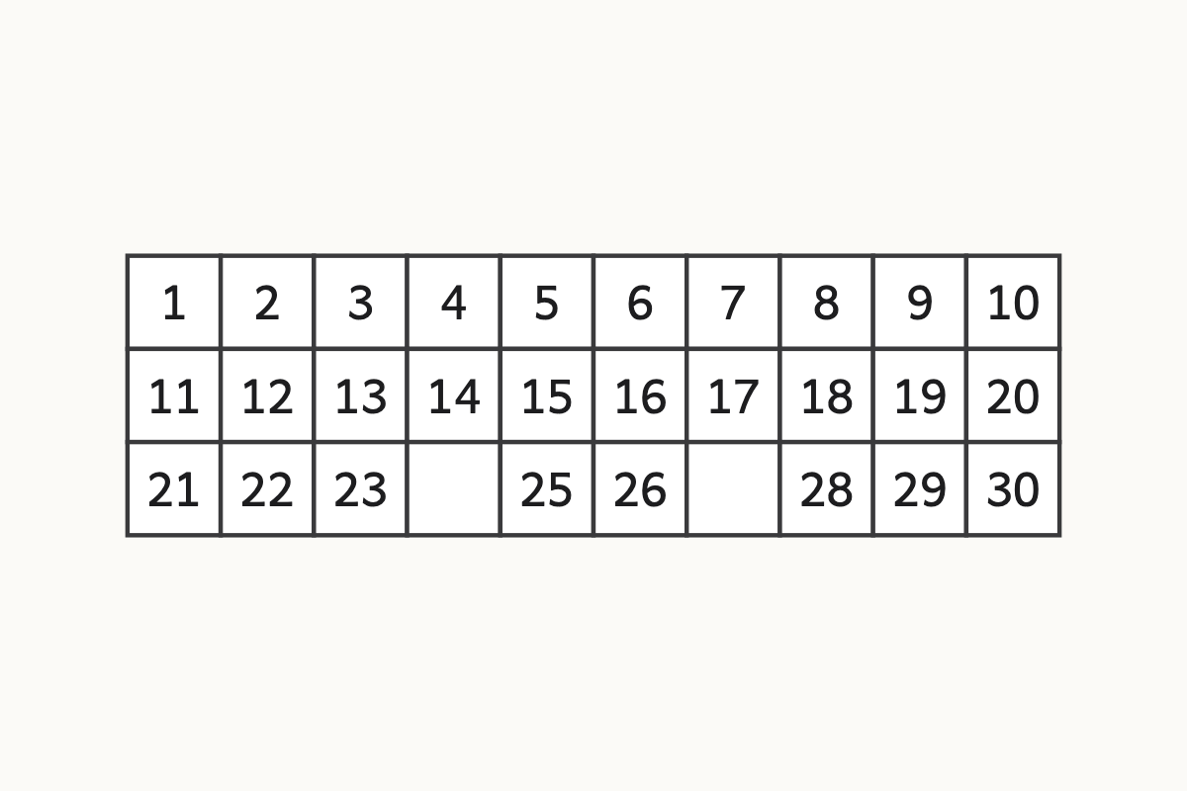
Find more hidden numbers
? ?
Education Makes Sense · educationmakessense.co.uk · Clear lessons. Confident learning.
Notes:
Two more numbers are hiding. After 23 comes... 24! And after 26 comes... 27! You know the pattern.

