Slide 1
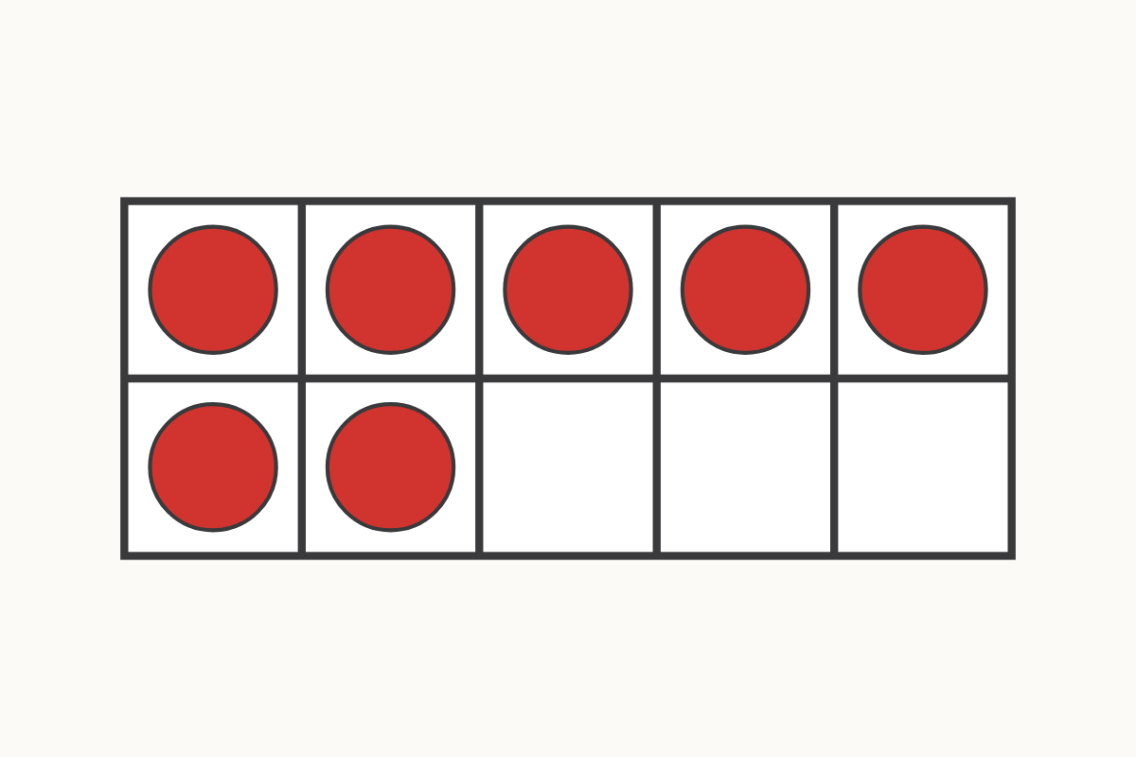
How many on the ten frame?
7
Education Makes Sense · educationmakessense.co.uk · Clear lessons. Confident learning.
Notes:
Let's count the counters together. 1, 2, 3, 4, 5, 6, 7. There are 7 counters on our ten frame. How many more boxes are empty?

Slide 2
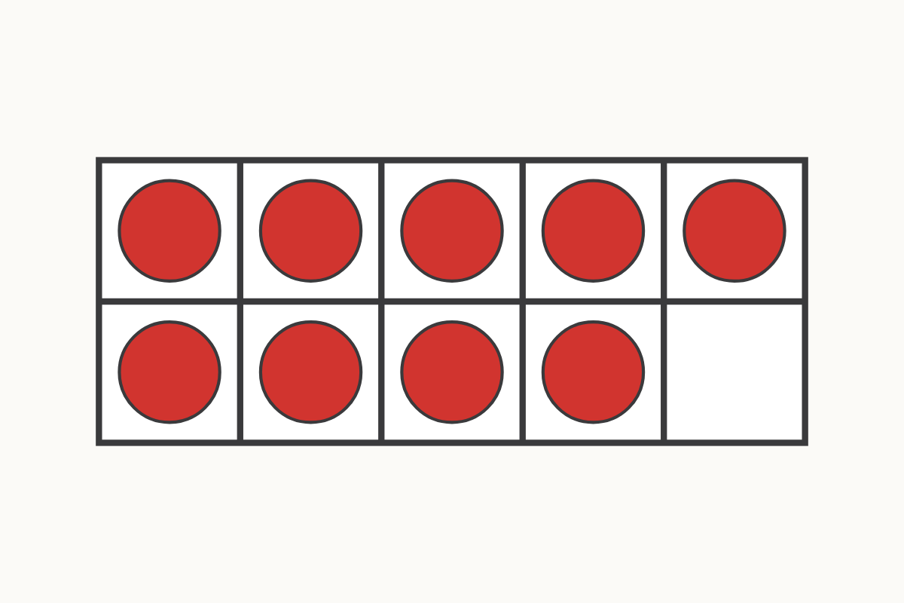
Filling the ten frame
9
Education Makes Sense · educationmakessense.co.uk · Clear lessons. Confident learning.
Notes:
Watch the ten frame fill up. Count with me. 1, 2, 3, 4, 5, 6, 7, 8, 9. There are 9 counters now. Only 1 empty box left.

Slide 3
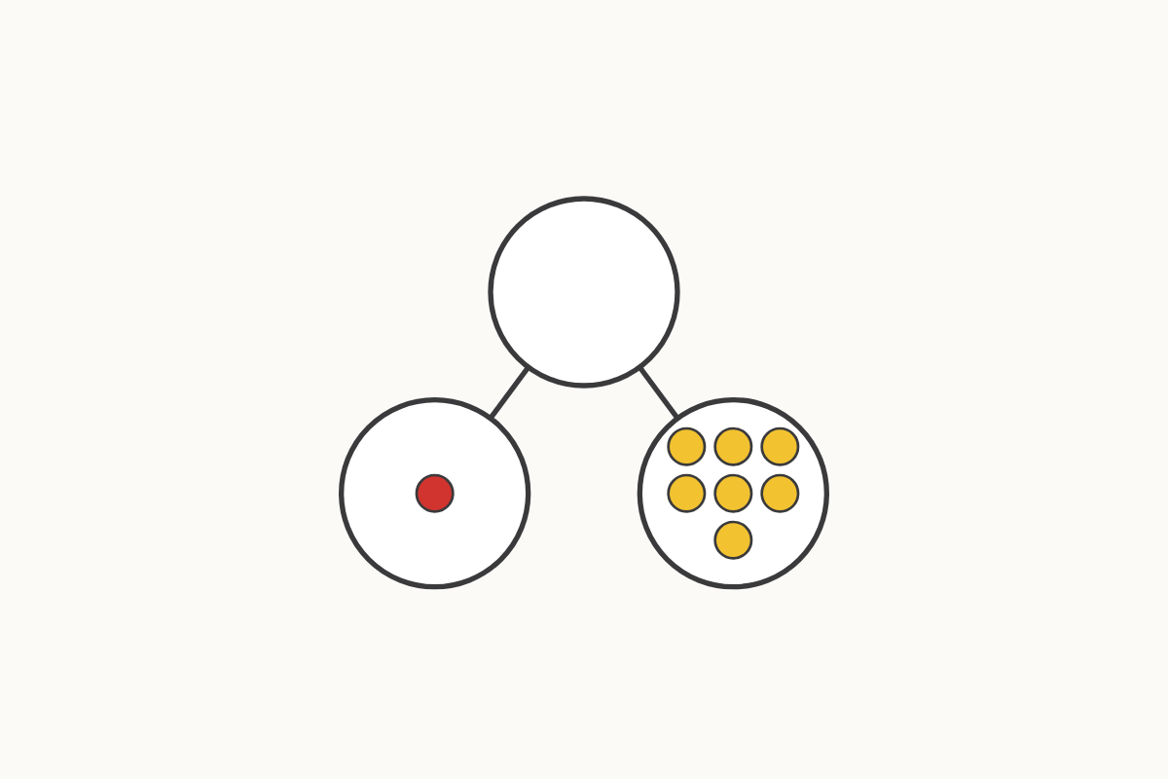
Parts that make 8
1 and 7
Education Makes Sense · educationmakessense.co.uk · Clear lessons. Confident learning.
Notes:
Here is our part-whole model. One part has 1, the other part has 7. 1 and 7 make 8.

Slide 4
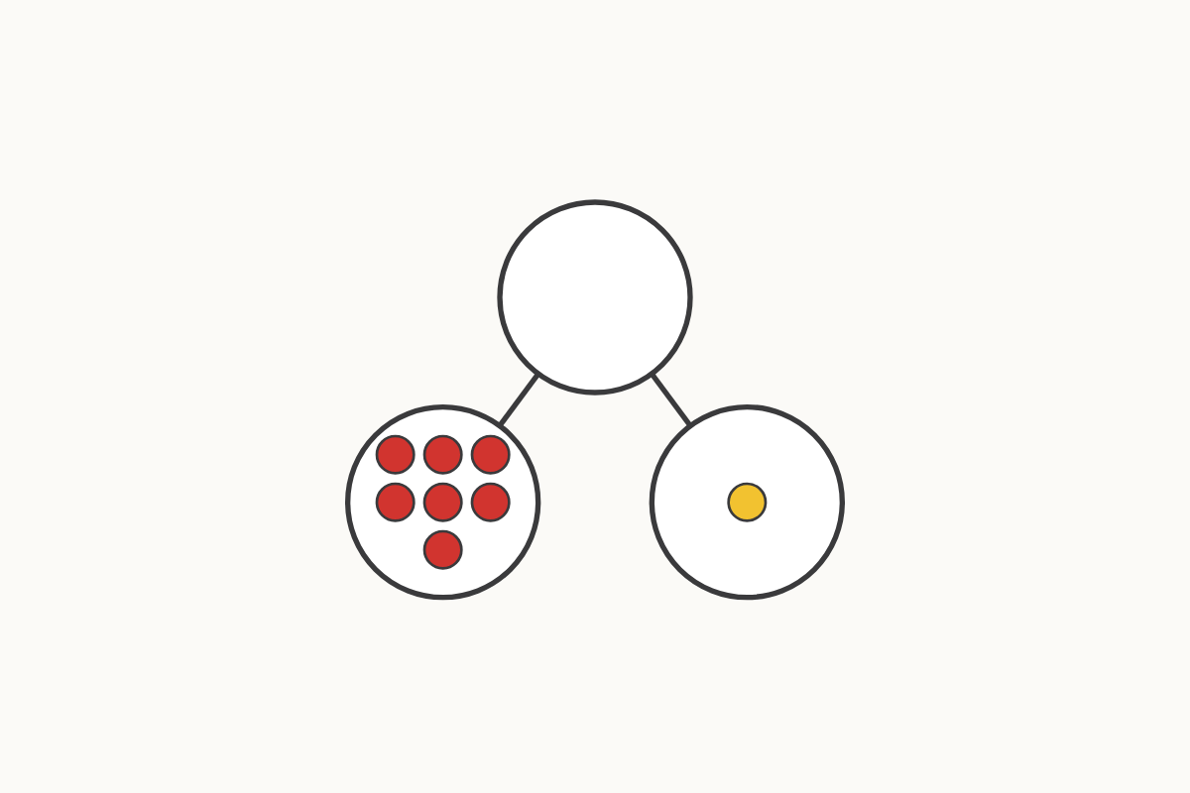
Parts that make 8
7 and 1
Education Makes Sense · educationmakessense.co.uk · Clear lessons. Confident learning.
Notes:
Look, I've swapped the parts around. Now it's 7 and 1. 7 and 1 still make 8. The parts can swap places.

Slide 5
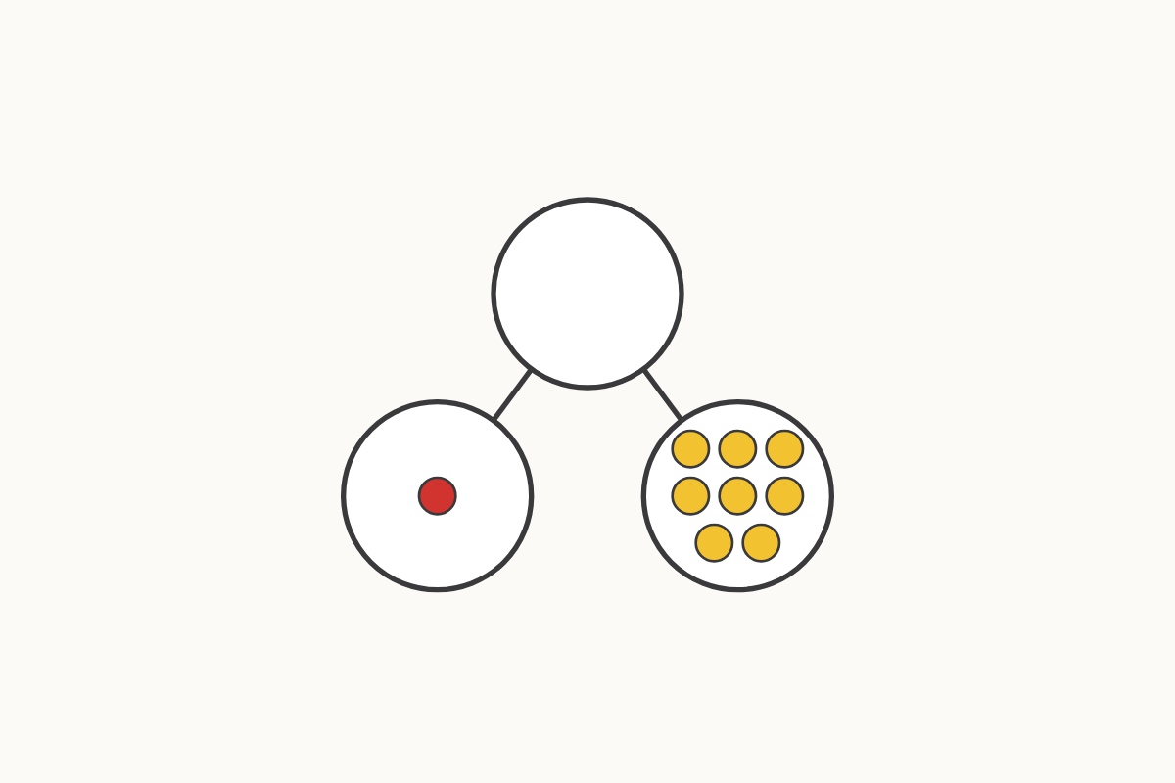
Parts that make 9
1 and 8
Education Makes Sense · educationmakessense.co.uk · Clear lessons. Confident learning.
Notes:
Now let's make 9. One part has 1, the other part has 8. 1 and 8 make 9.

Slide 6
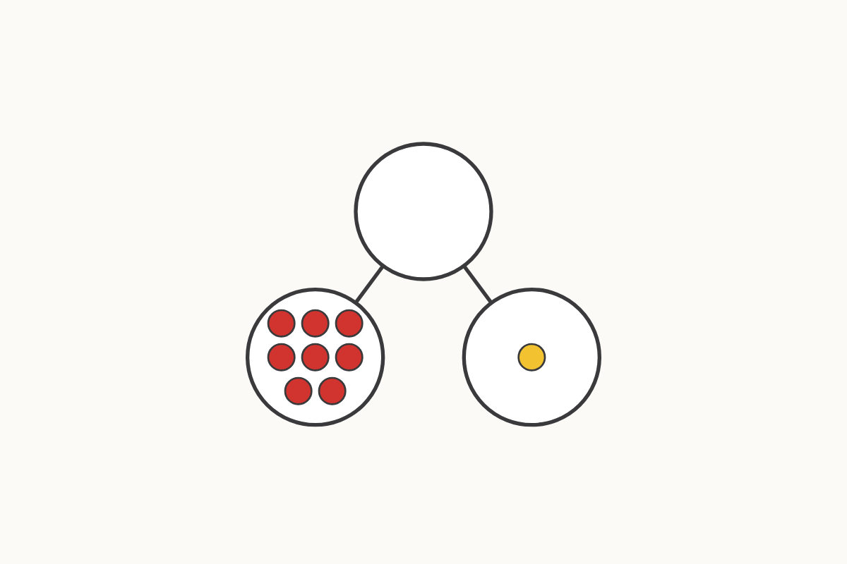
Parts that make 9
8 and 1
Education Makes Sense · educationmakessense.co.uk · Clear lessons. Confident learning.
Notes:
I've swapped these parts too. Now it's 8 and 1. 8 and 1 make 9 as well.

Slide 7
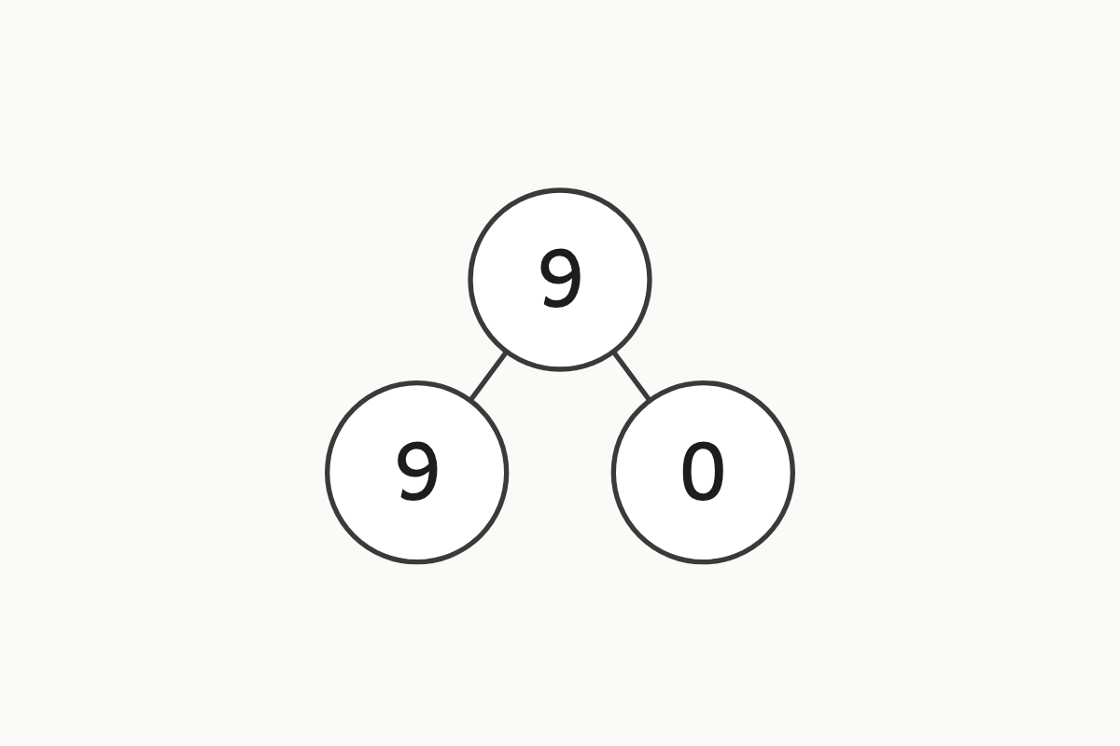
Parts that make 9
9 and 0
Education Makes Sense · educationmakessense.co.uk · Clear lessons. Confident learning.
Notes:
This time one part has 9 and the other part has 0. Zero means none at all. 9 and 0 make 9.

Slide 8
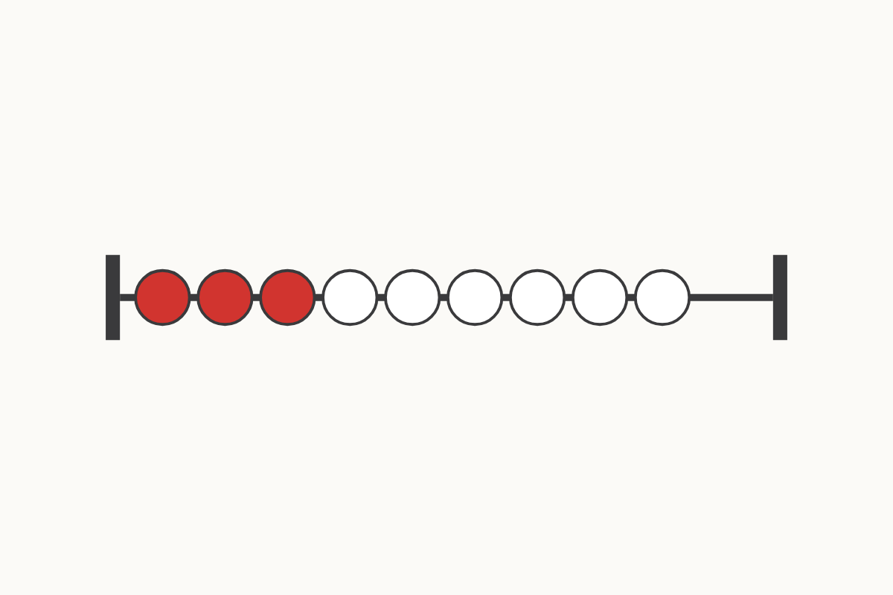
Beads on the rekenrek
3 and 6
Education Makes Sense · educationmakessense.co.uk · Clear lessons. Confident learning.
Notes:
Look at our rekenrek. There are 3 red beads and 6 white beads. 3 and 6 make 9.

