Slide 1
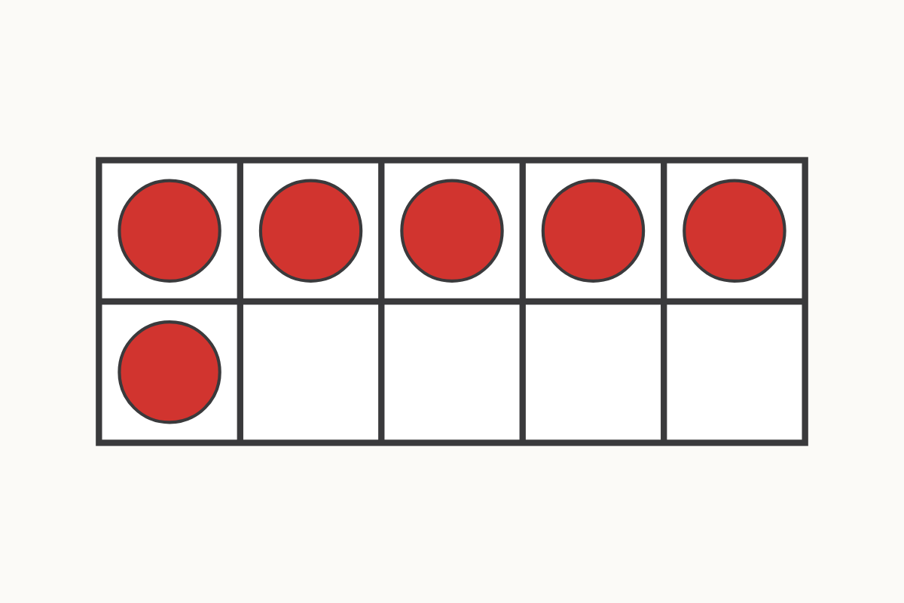
How many on the ten frame?
6
Education Makes Sense · educationmakessense.co.uk · Clear lessons. Confident learning.
Notes:
Let's look at our ten frame on the carpet. Can you see the dots? Count them with your partner... yes, 6! How many more dots would we need to make 8?

Slide 2
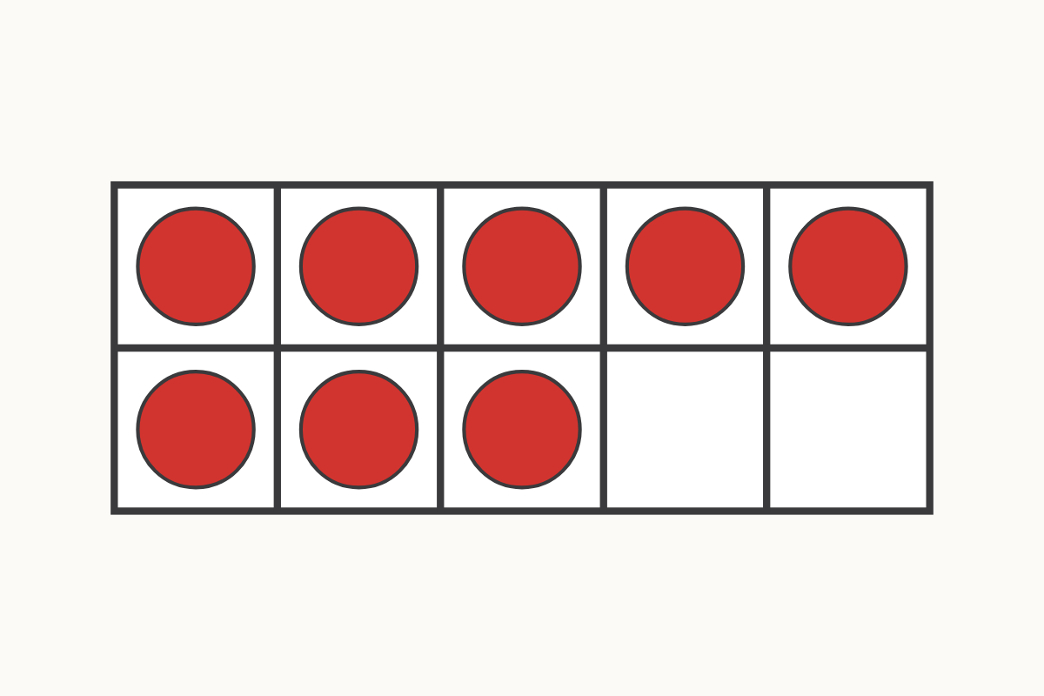
A full ten frame
8
Education Makes Sense · educationmakessense.co.uk · Clear lessons. Confident learning.
Notes:
Now look at this ten frame. Count every dot with me... 1, 2, 3, 4, 5, 6, 7, 8. That's 8 dots altogether.

Slide 3
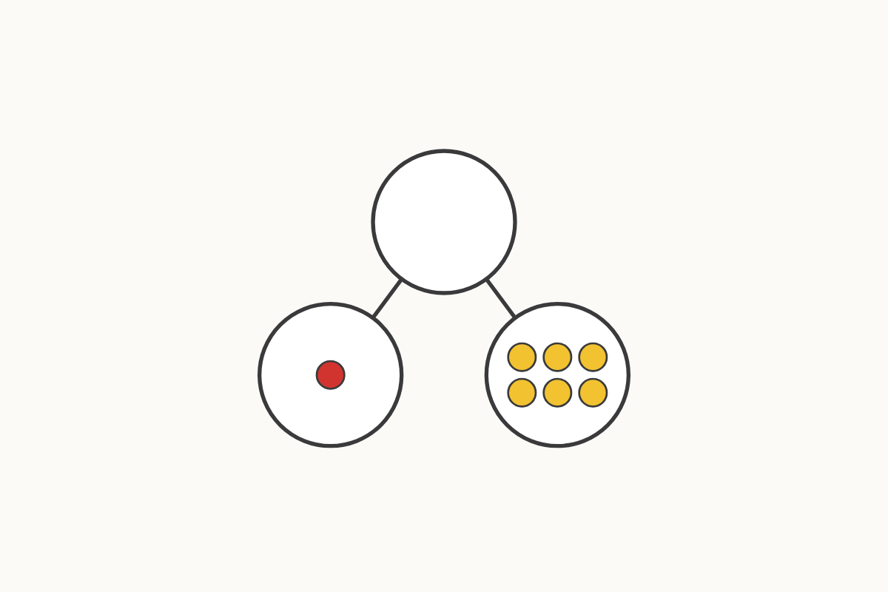
Parts that make 7
1 and 6
Education Makes Sense · educationmakessense.co.uk · Clear lessons. Confident learning.
Notes:
Here is 7 split into two parts. One part has 1, the other part has 6. 1 and 6 make 7.

Slide 4
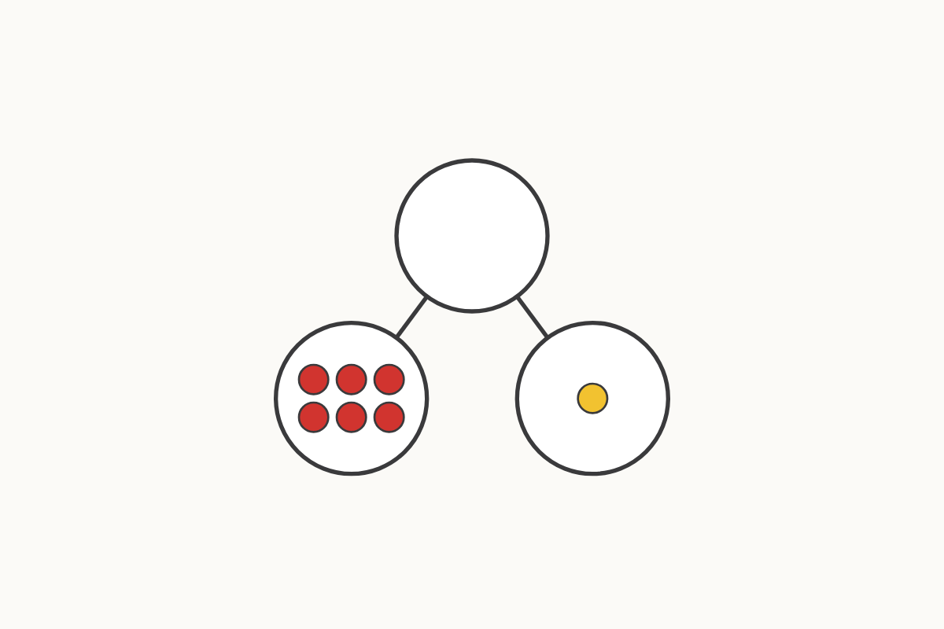
Parts that make 7
6 and 1
Education Makes Sense · educationmakessense.co.uk · Clear lessons. Confident learning.
Notes:
Look carefully — the parts have swapped places! Now it's 6 and 1. Does it still make 7? Yes it does, the parts can switch order.

Slide 5
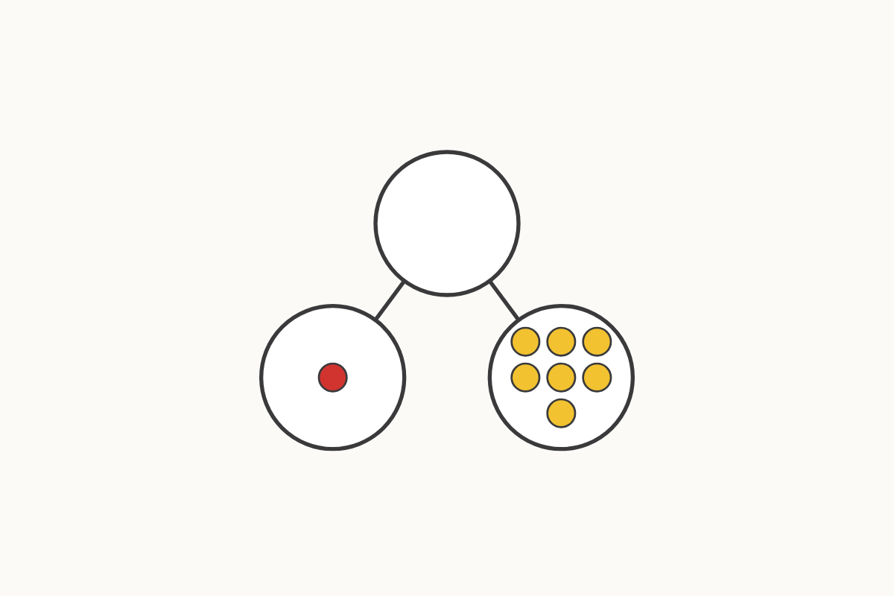
Parts that make 8
1 and 7
Education Makes Sense · educationmakessense.co.uk · Clear lessons. Confident learning.
Notes:
Now we're thinking about 8. This whole is split into 1 and 7. Say it with me: 1 and 7 make 8.

Slide 6
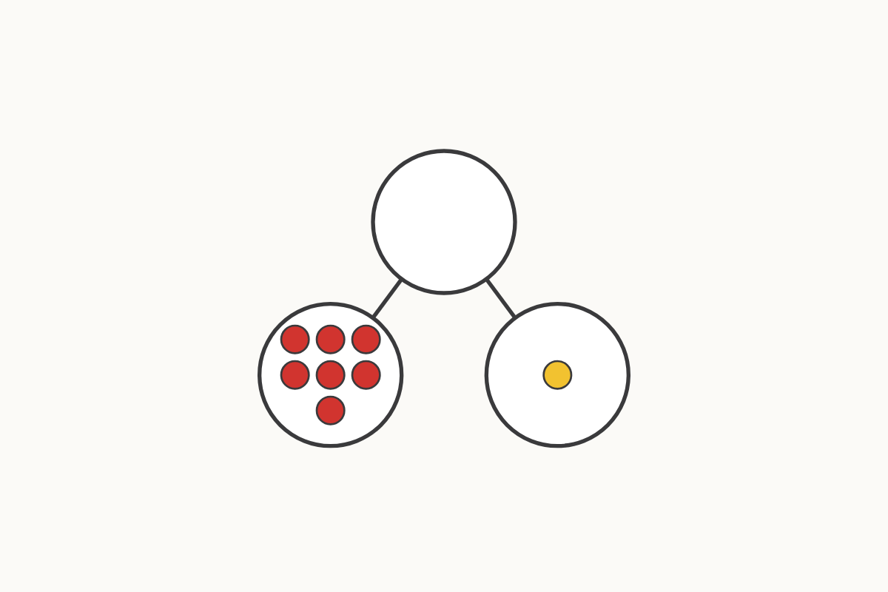
Parts that make 8
7 and 1
Education Makes Sense · educationmakessense.co.uk · Clear lessons. Confident learning.
Notes:
The parts have swapped again! 7 and 1 — does it still make 8? Let's check together: yes, 7 and 1 make 8.

Slide 7
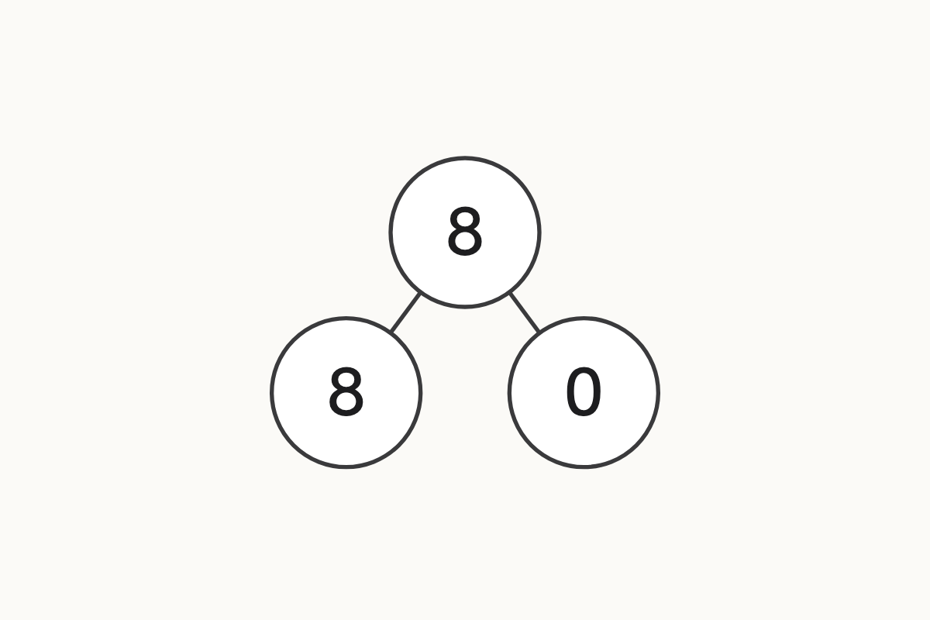
What if one part is zero?
8 and 0
Education Makes Sense · educationmakessense.co.uk · Clear lessons. Confident learning.
Notes:
This time one part has 8 and the other part has nothing at all — 0. 8 and 0 make 8. If we take away 0, we still have all 8 left.

Slide 8
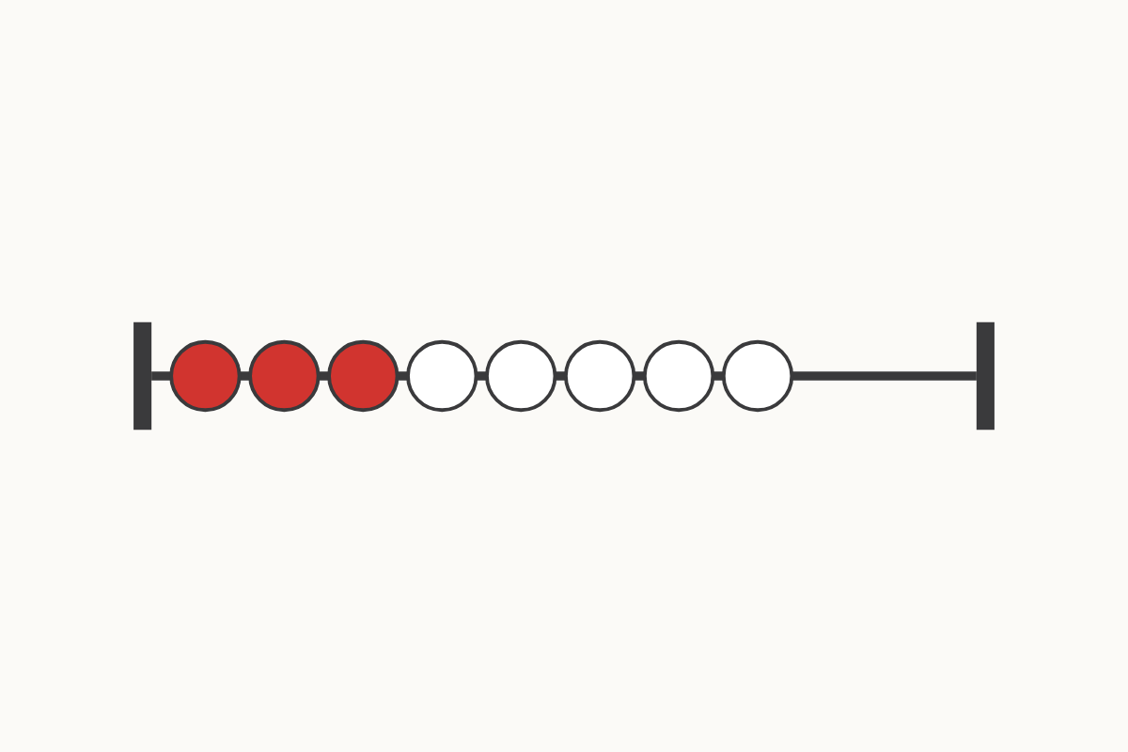
Red beads and white beads
3 and 5
Education Makes Sense · educationmakessense.co.uk · Clear lessons. Confident learning.
Notes:
Look at our rekenrek. Count the red beads... 3. Now count the white beads... 5. 3 and 5 make 8 altogether.

