Slide 1
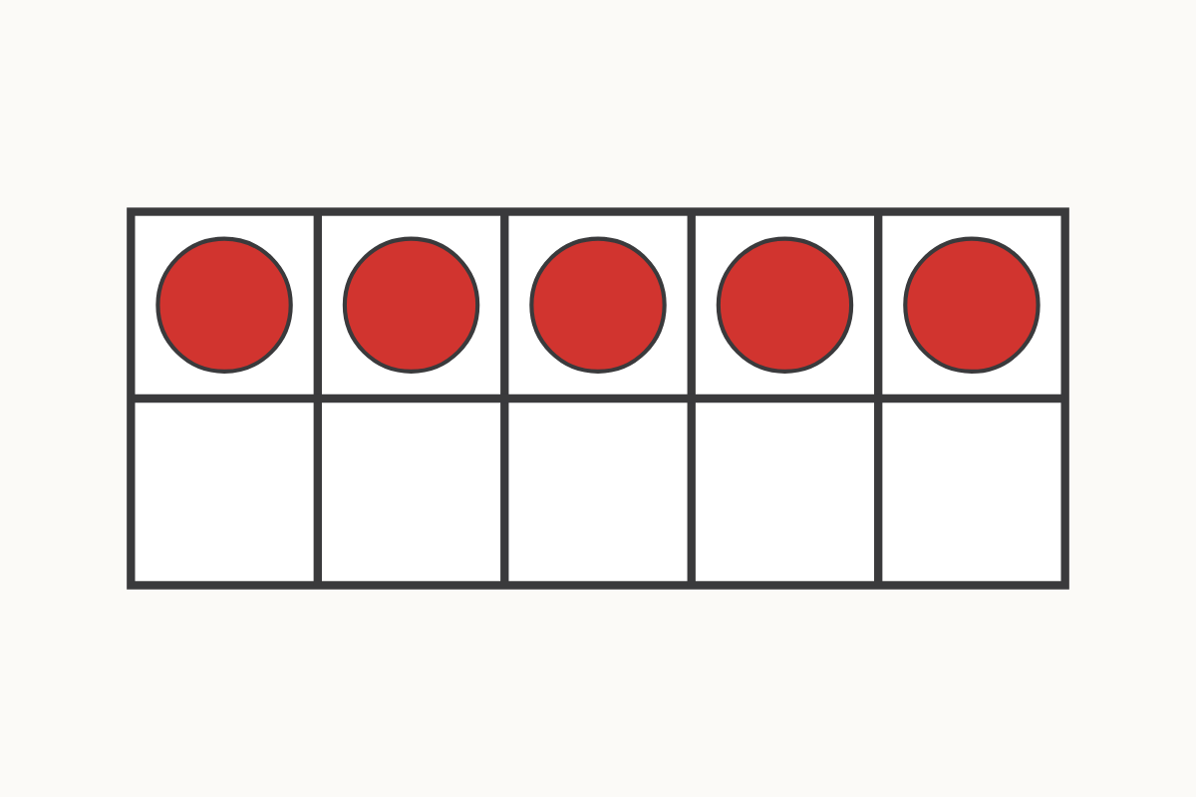
How many on the ten frame?
5
Education Makes Sense · educationmakessense.co.uk · Clear lessons. Confident learning.
Notes:
Let's look at our ten frame together. Count with me: 1, 2, 3, 4, 5. There are 5 counters. How many more would we need to make 7? That's right, 5 and 2 make 7.

Slide 2
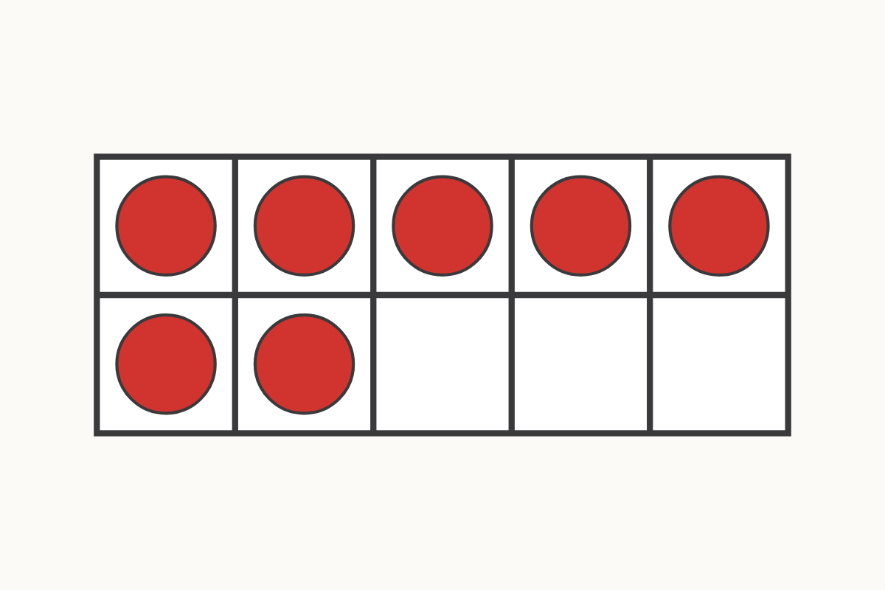
A ten frame showing 7
7
Education Makes Sense · educationmakessense.co.uk · Clear lessons. Confident learning.
Notes:
Now our ten frame looks fuller. Let's count together: 1, 2, 3, 4, 5, 6, 7. There are 7 counters here. The ten frame shows us 7.

Slide 3
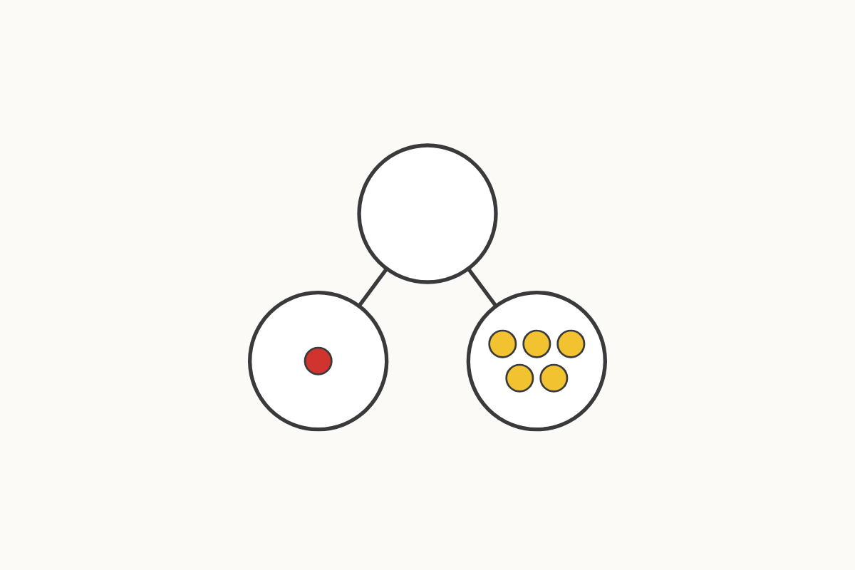
Splitting 6: 1 and 5
1 and 5
Education Makes Sense · educationmakessense.co.uk · Clear lessons. Confident learning.
Notes:
Look at our part-whole model. One part has 1 and the other part has 5. 1 and 5 make 6.

Slide 4
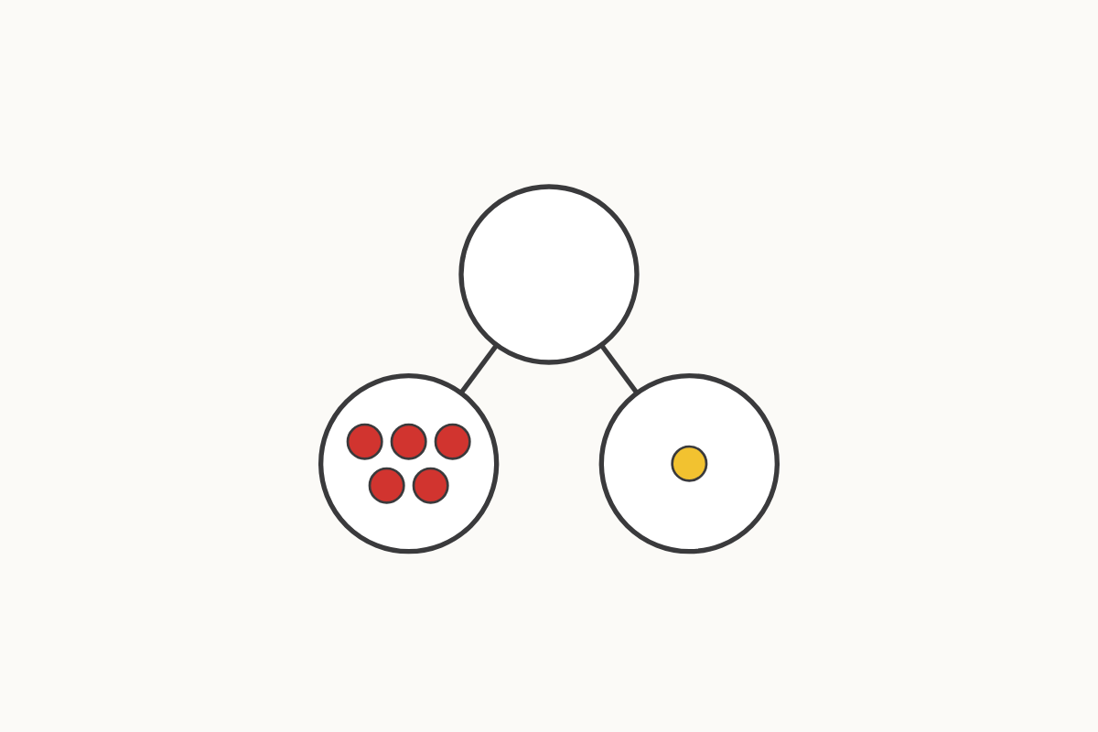
Splitting 6: 5 and 1
5 and 1
Education Makes Sense · educationmakessense.co.uk · Clear lessons. Confident learning.
Notes:
Now the parts have swapped round. 5 and 1 still make 6. It's the same two parts, just the other way round.

Slide 5
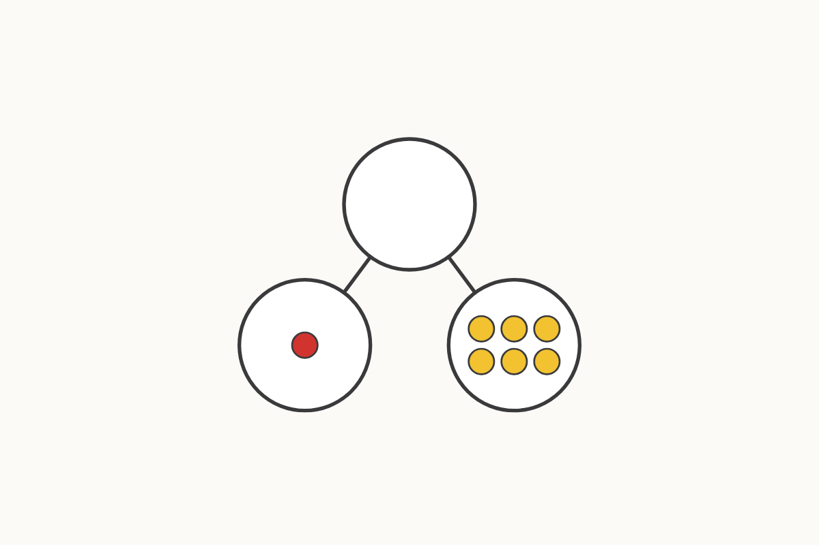
Splitting 7: 1 and 6
1 and 6
Education Makes Sense · educationmakessense.co.uk · Clear lessons. Confident learning.
Notes:
Now let's split 7. One part has 1 and the other part has 6. 1 and 6 make 7.

Slide 6
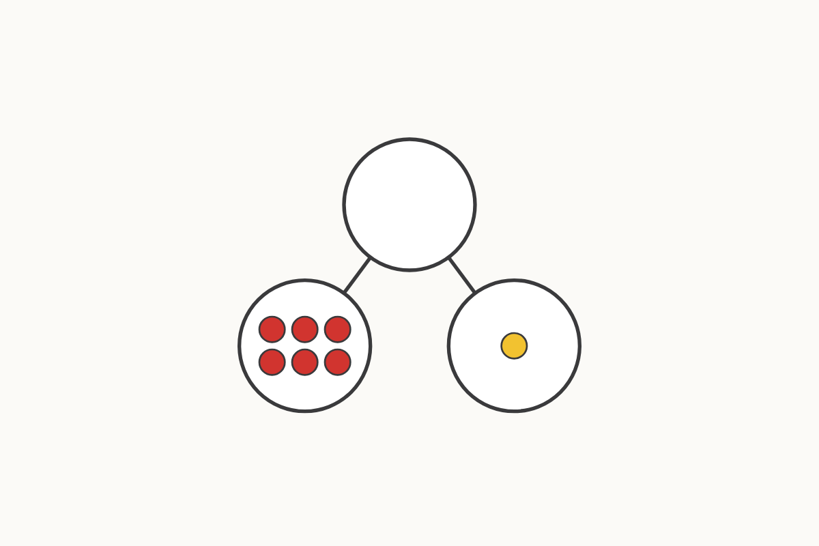
Splitting 7: 6 and 1
6 and 1
Education Makes Sense · educationmakessense.co.uk · Clear lessons. Confident learning.
Notes:
Let's swap the parts round, just like we did before. 6 and 1 still make 7.

Slide 7
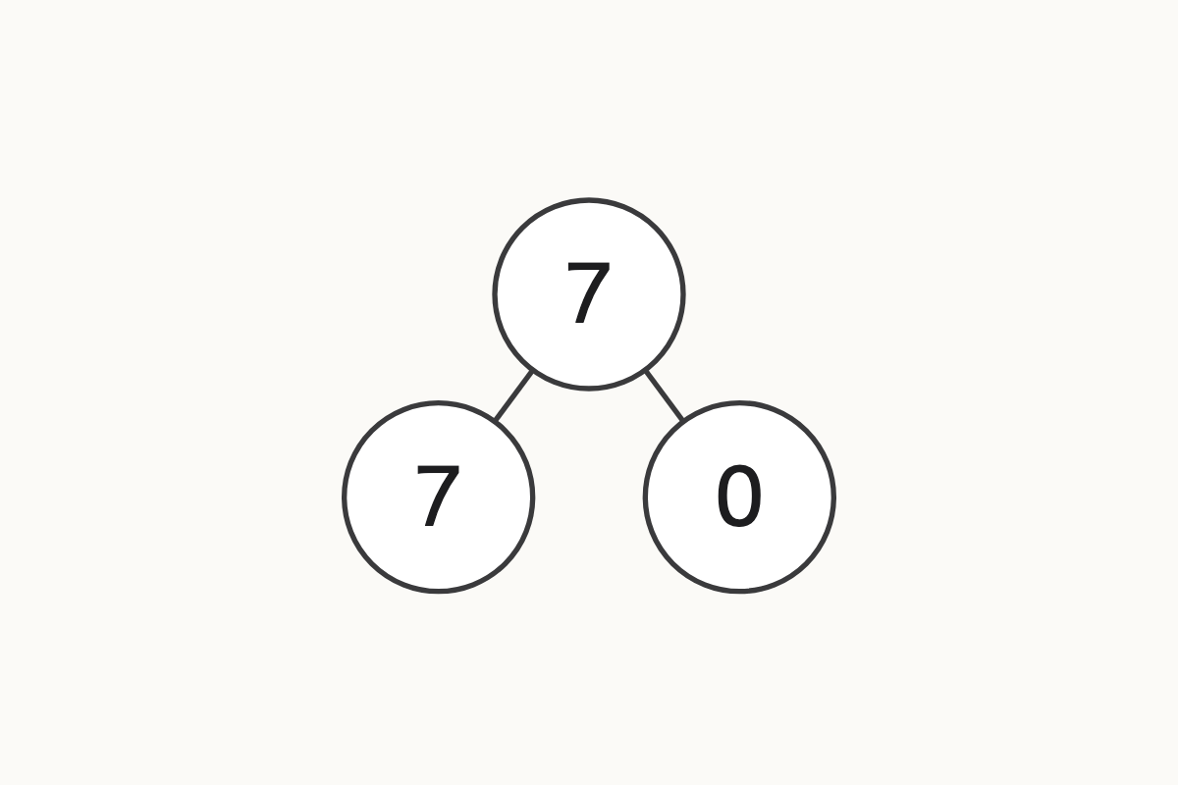
Splitting 7: 7 and 0
7 and 0
Education Makes Sense · educationmakessense.co.uk · Clear lessons. Confident learning.
Notes:
What if one part has nothing in it at all? 7 and 0 make 7. Zero means none.

Slide 8
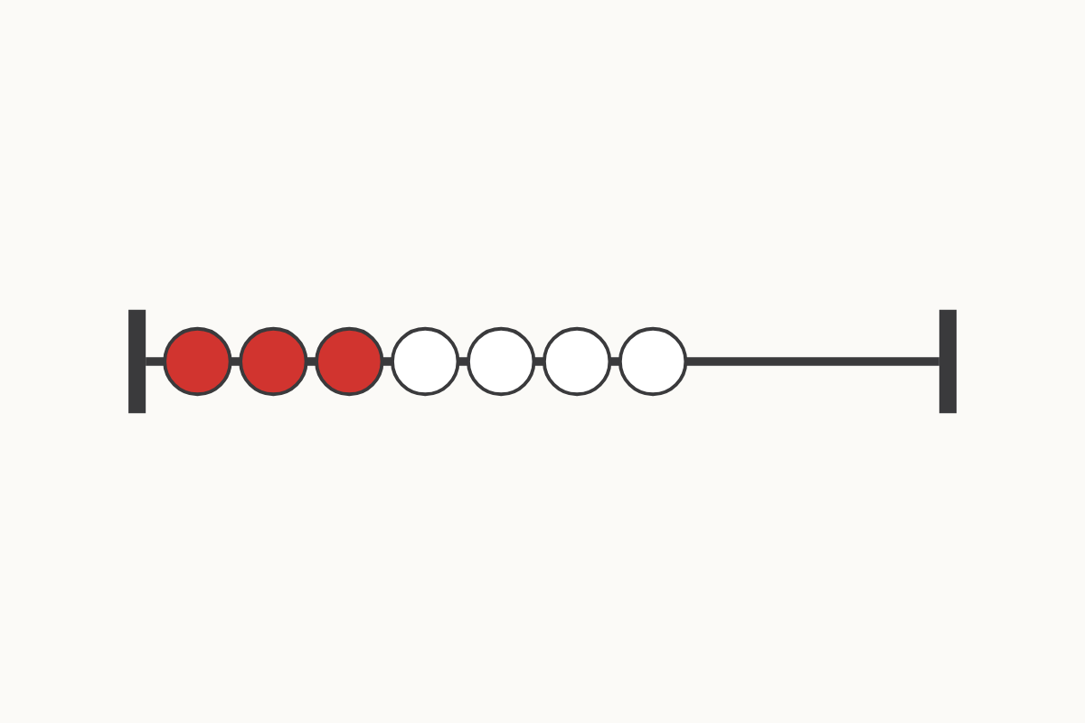
Red and white beads
3 and 4
Education Makes Sense · educationmakessense.co.uk · Clear lessons. Confident learning.
Notes:
On our rekenrek we have 3 red beads and 4 white beads. 3 and 4 make 7. Can anyone think of another way we could make 7?

