Slide 1
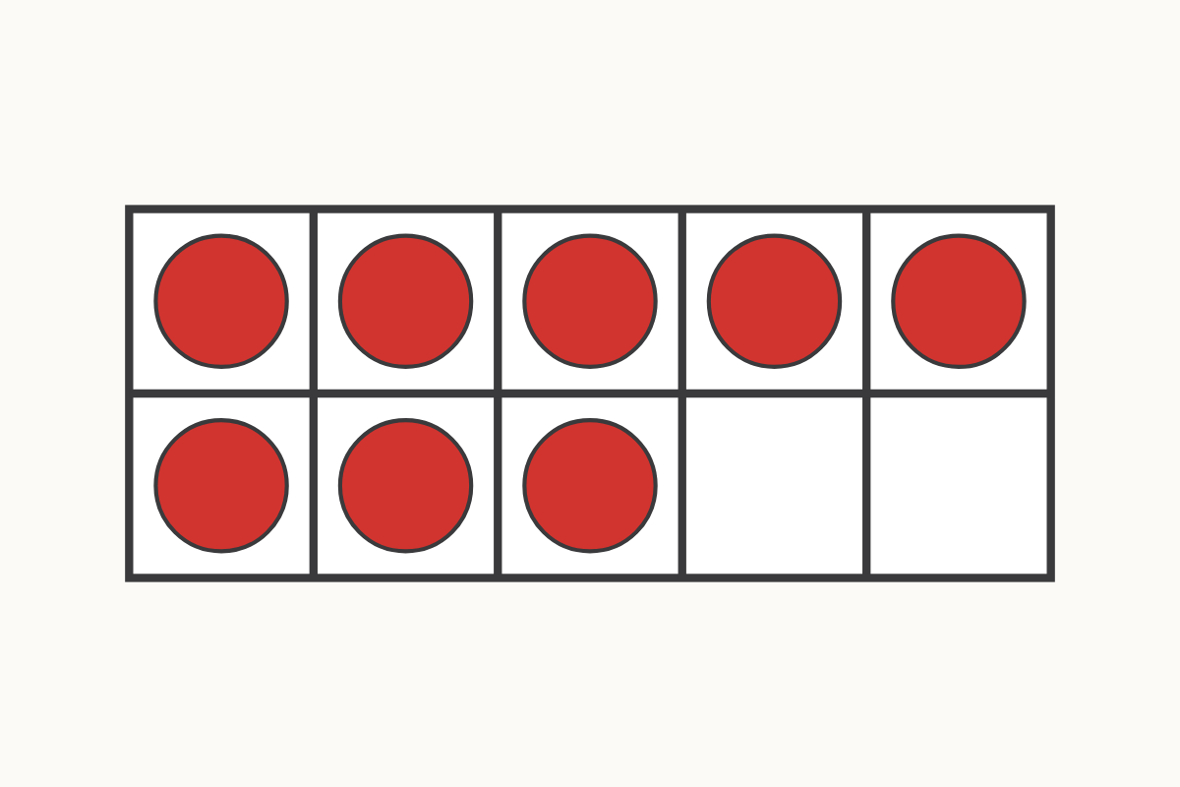
How many on the ten frame?
8
Education Makes Sense · educationmakessense.co.uk · Clear lessons. Confident learning.
Notes:
Let's look at our ten frame together. Can you see how many counters are on it? That's right, there are 8. How many more would we need to fill the whole frame and make 10?

Slide 2
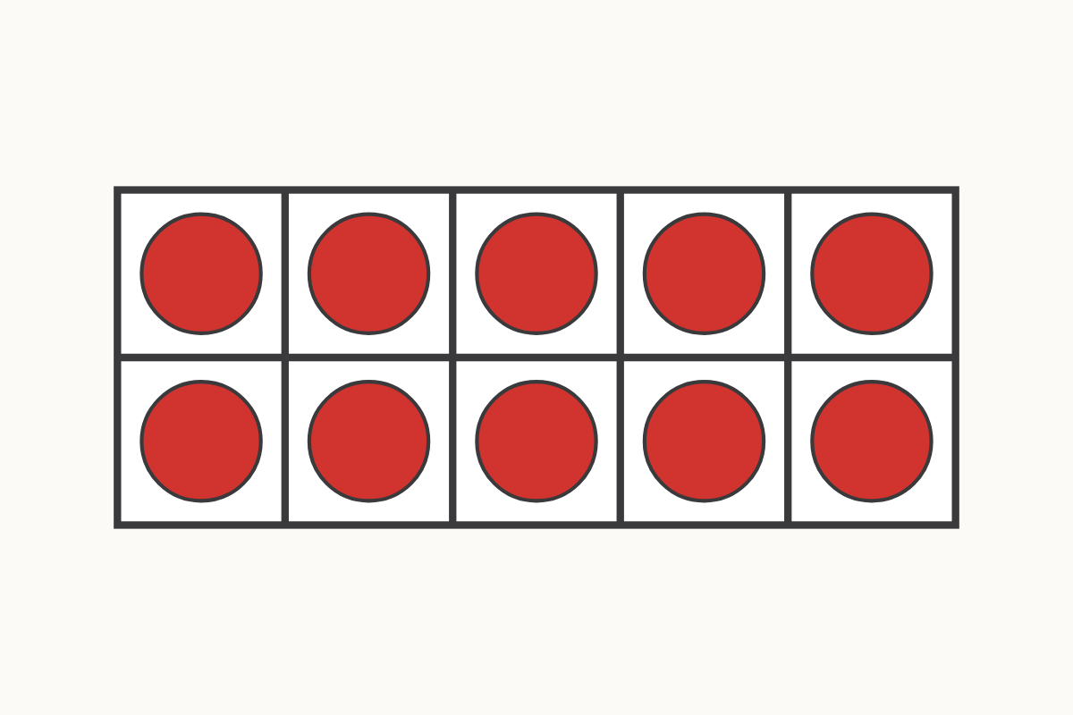
A full ten frame!
10
Education Makes Sense · educationmakessense.co.uk · Clear lessons. Confident learning.
Notes:
Now look at this ten frame. Every single space is full. Let's count them together. Yes, 10! When all the spaces are full, we have 10.

Slide 3
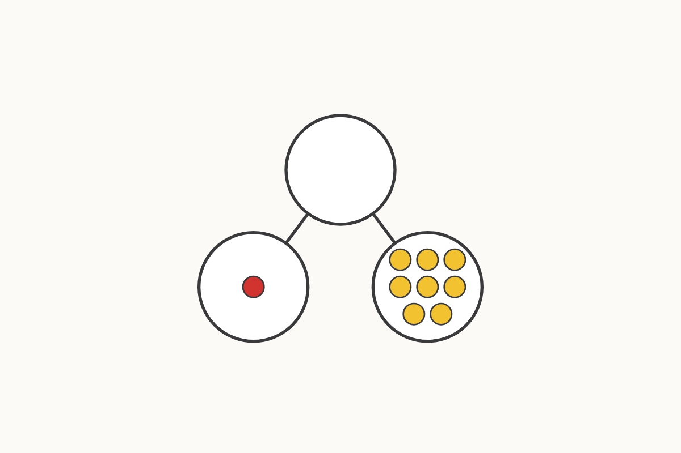
Parts of 9
1 and 8
Education Makes Sense · educationmakessense.co.uk · Clear lessons. Confident learning.
Notes:
Here is 9 split into two parts. One part has 1, and the other part has 8. 1 and 8 together make 9.

Slide 4
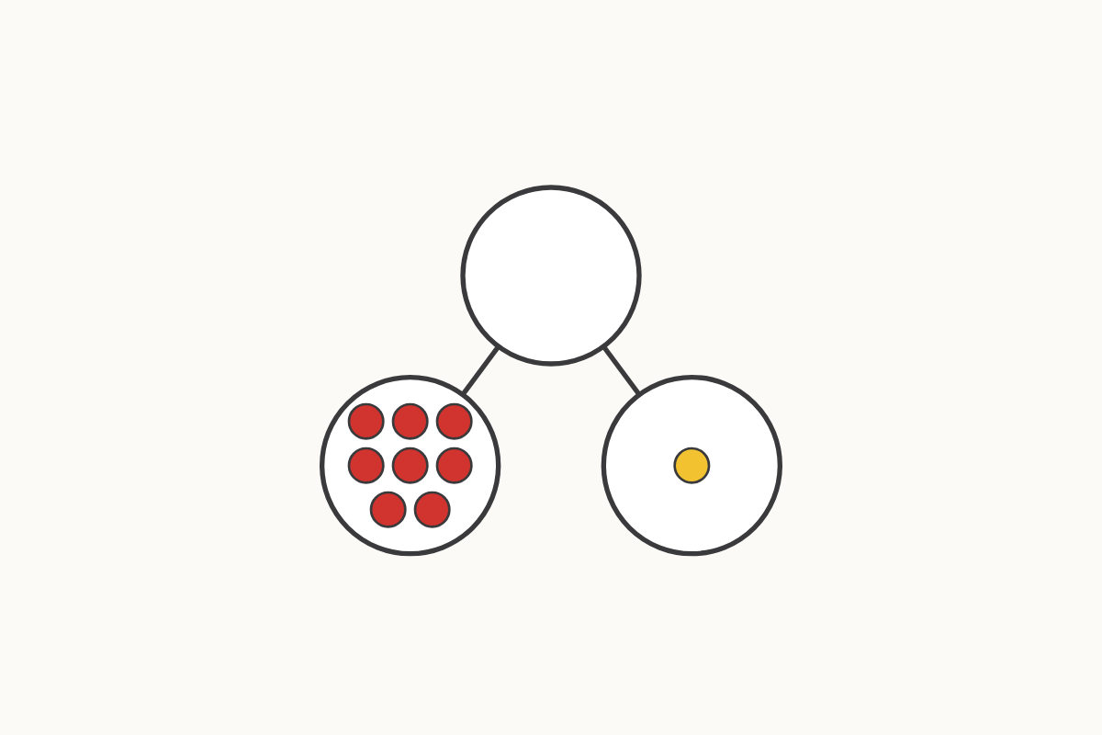
Parts of 9, swapped
8 and 1
Education Makes Sense · educationmakessense.co.uk · Clear lessons. Confident learning.
Notes:
Look, the parts have swapped places! Now 8 is first and 1 is second. 8 and 1 still make 9, just like before.

Slide 5
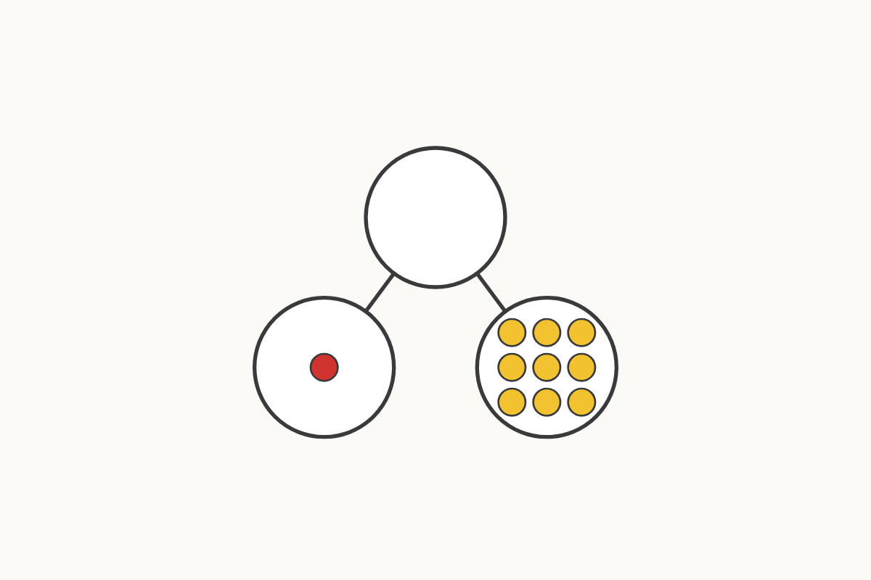
Parts of 10
1 and 9
Education Makes Sense · educationmakessense.co.uk · Clear lessons. Confident learning.
Notes:
This time our whole is 10. One part is 1, and the other part is 9. 1 and 9 together make 10.

Slide 6
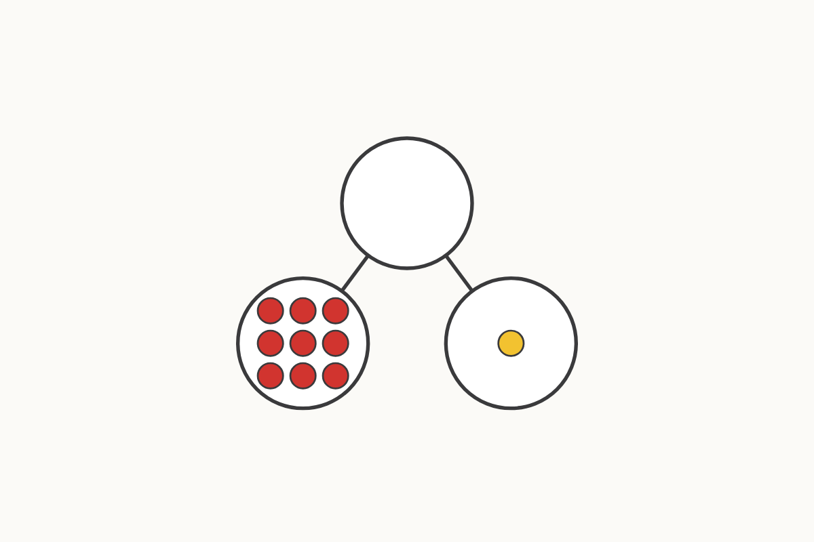
Parts of 10, swapped
9 and 1
Education Makes Sense · educationmakessense.co.uk · Clear lessons. Confident learning.
Notes:
The parts have swapped around again. Now 9 comes first and 1 comes second. 9 and 1 still make 10.

Slide 7
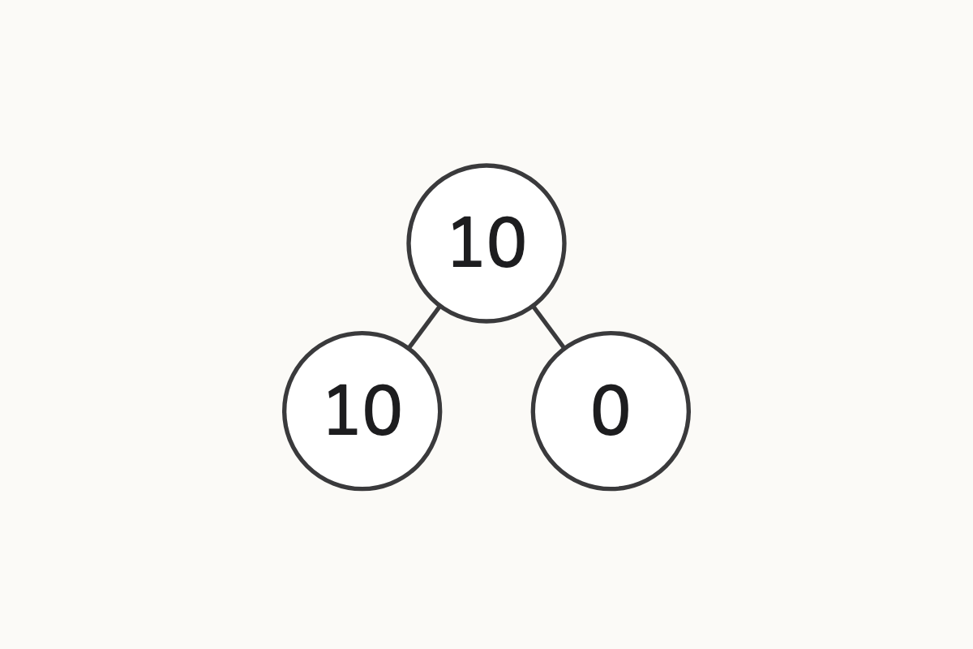
What if one part is empty?
10 and 0
Education Makes Sense · educationmakessense.co.uk · Clear lessons. Confident learning.
Notes:
Look carefully at this part-whole model. One part has 10, and the other part has 0, nothing at all. 10 and 0 still make 10.

Slide 8
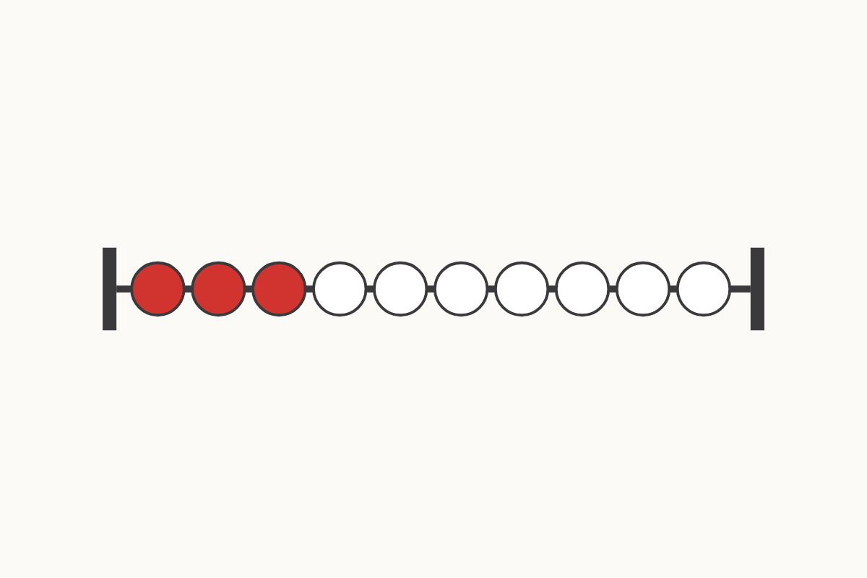
Beads on the rekenrek
3 and 7
Education Makes Sense · educationmakessense.co.uk · Clear lessons. Confident learning.
Notes:
Look at our rekenrek. There are 3 red beads and 7 white beads. 3 and 7 together make 10 beads altogether.

