Slide 1
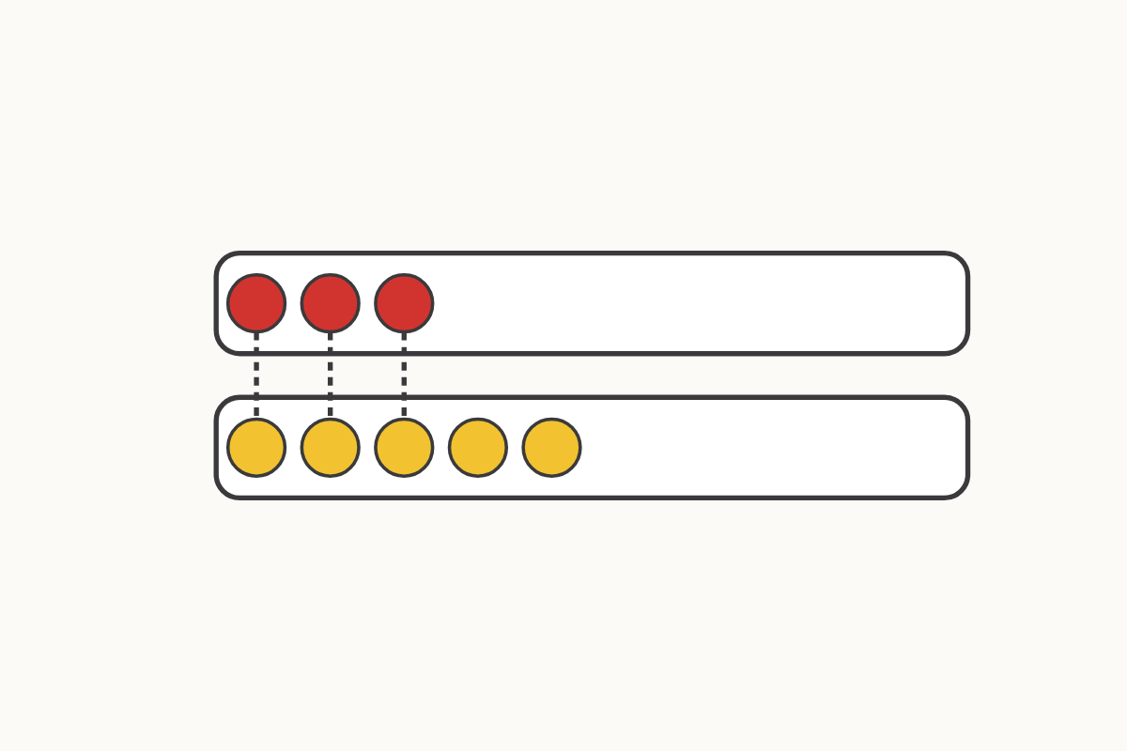
Comparing two groups
3 5
Education Makes Sense · educationmakessense.co.uk · Clear lessons. Confident learning.
Notes:
Let's line up our counters in pairs, like partners on the carpet. Every counter in the top row has found a partner in the bottom row, but look — some counters in the bottom row have no partner! That tells us 5 is more than 3, and 3 is fewer than 5.

Slide 2
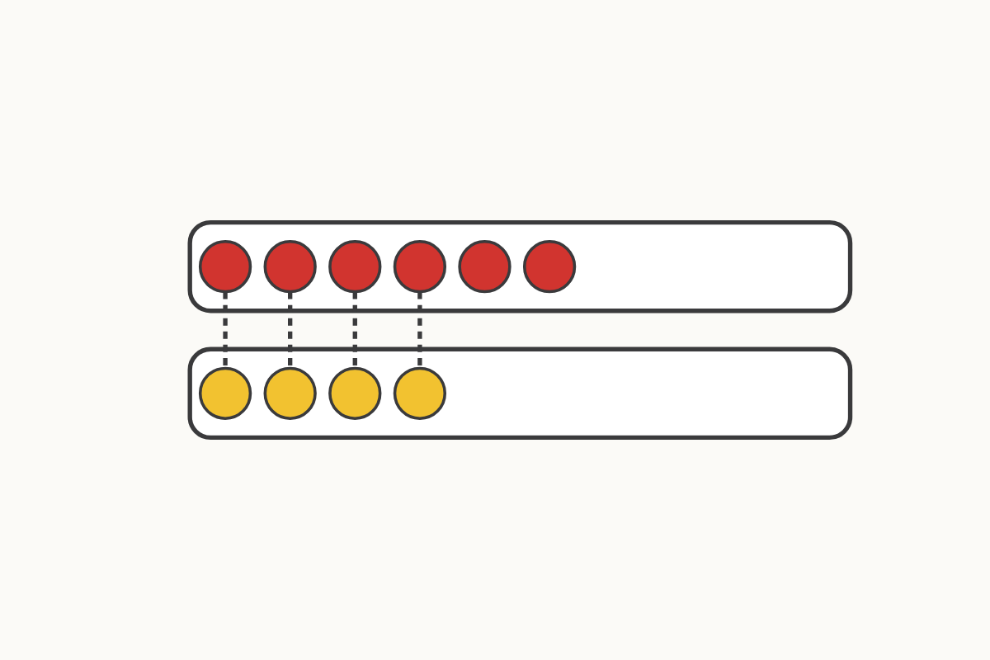
Which group has more?
6 4
Education Makes Sense · educationmakessense.co.uk · Clear lessons. Confident learning.
Notes:
We've joined each pair with a dotted line. This time the top row has counters left over with no partner, so the top row has more. 6 is more than 4, and 4 is fewer than 6.

Slide 3
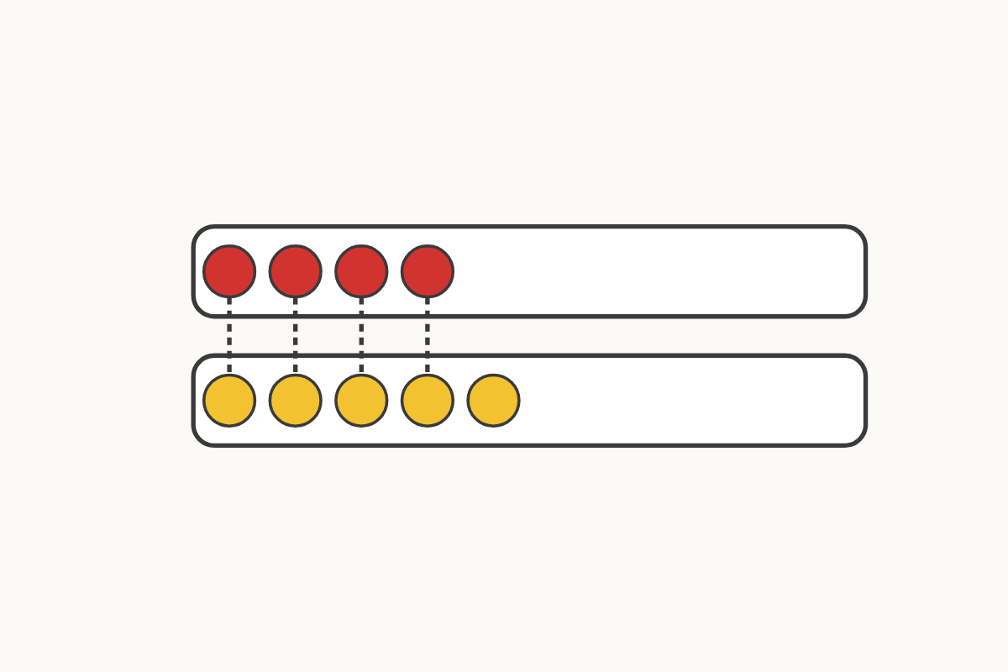
Spot the extra one
4 5
Education Makes Sense · educationmakessense.co.uk · Clear lessons. Confident learning.
Notes:
Follow the dotted lines along each pair. Every counter in the top row has a partner, but one counter in the bottom row is on its own. That means 5 is more than 4, and 4 is fewer than 5.

Slide 4
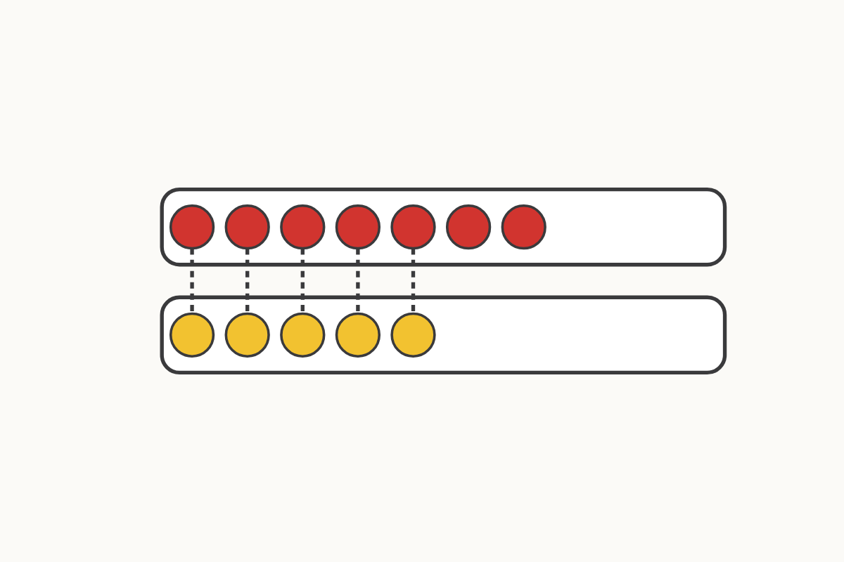
How many more?
7 5
Education Makes Sense · educationmakessense.co.uk · Clear lessons. Confident learning.
Notes:
Look along the pairs joined by dotted lines. The bottom row runs out first, and the top row still has counters with no partner. 7 is more than 5, and 5 is fewer than 7.

Slide 5
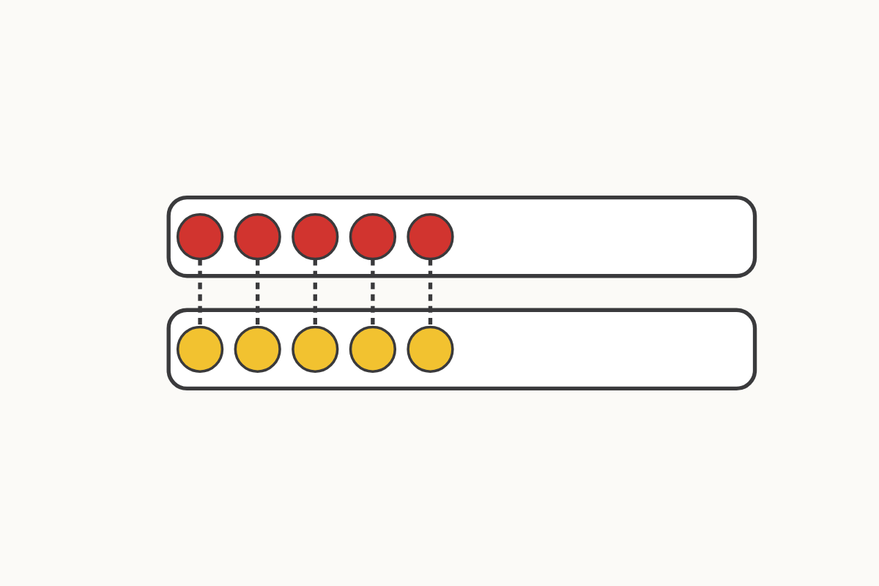
Same or different?
5 5
Education Makes Sense · educationmakessense.co.uk · Clear lessons. Confident learning.
Notes:
Let's check every pair along the dotted lines. Look carefully... every single counter has found a partner, and none are left over in either row! 5 and 5 are the same.

Slide 6
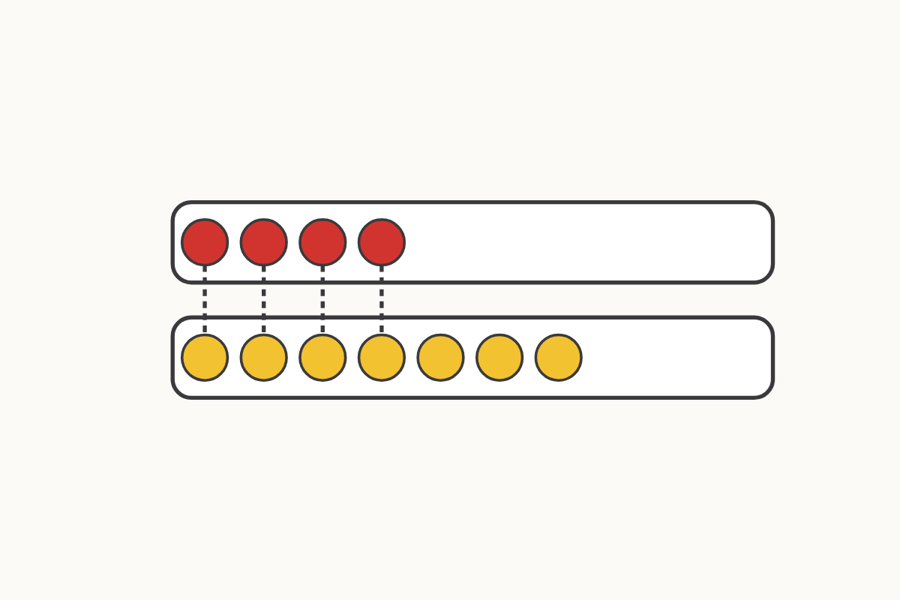
Making groups the same
4 7
Education Makes Sense · educationmakessense.co.uk · Clear lessons. Confident learning.
Notes:
Follow the dotted lines from the top row to the bottom row. The bottom row has lots of counters with no partner. 7 is more than 4, and 4 is fewer than 7. What could we add to the top row to make these two groups the same?

Slide 7
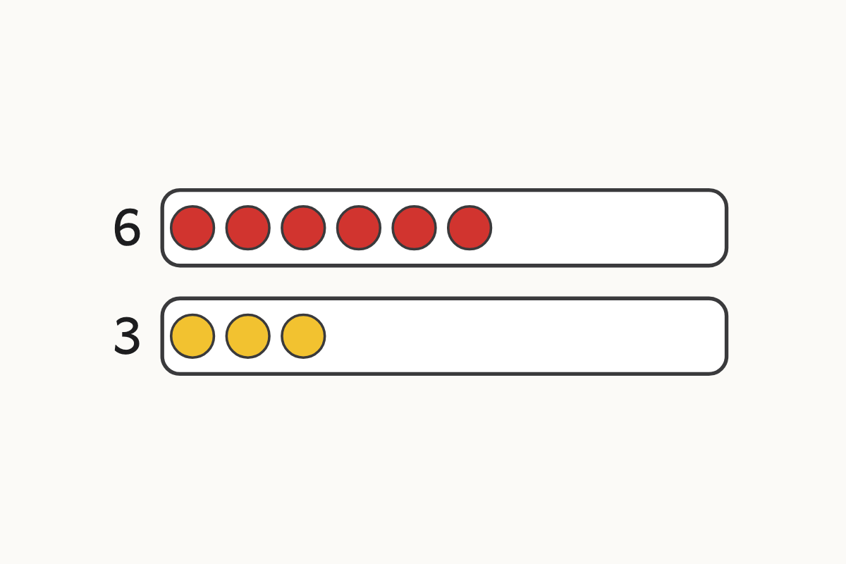
More than, fewer than
6 3
Education Makes Sense · educationmakessense.co.uk · Clear lessons. Confident learning.
Notes:
Here are our numerals, 6 and 3, next to the counters. 6 is more than 3, and 3 is fewer than 6. 6 is 3 more than 3.

Slide 8
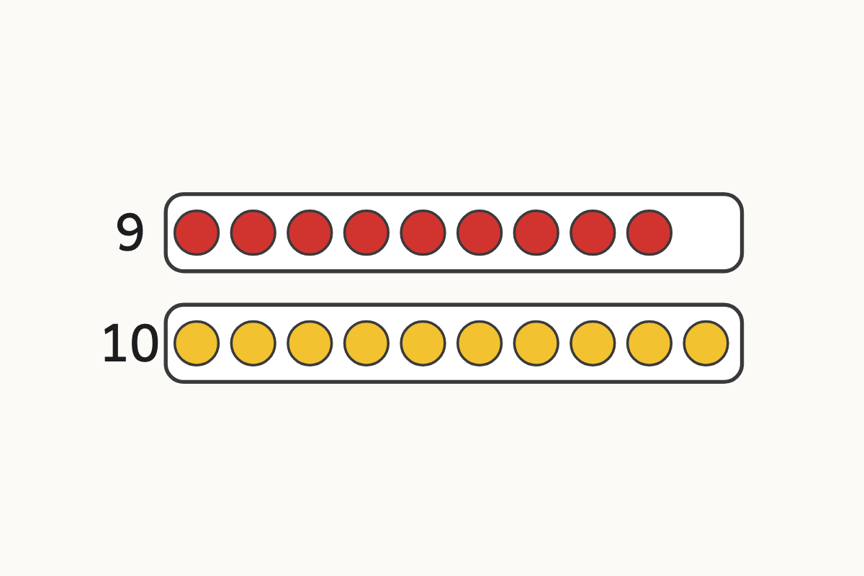
Comparing with numerals
9 10
Education Makes Sense · educationmakessense.co.uk · Clear lessons. Confident learning.
Notes:
Look at the numerals 9 and 10 beside our rows. 10 is more than 9, and 9 is fewer than 10. 10 is 1 more than 9.

